Slide 1
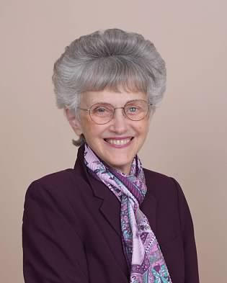

Update Report to Eastern PA Conference
Bishop Peggy A. Johnson
May 6, 2021

Slide 2
EPA Conference Mission: United in Christ, Committed to Transformation
Creating Disciples
Celebrating Diversity
Connecting Communities
Committing to love and justice

Slide 3
New Date for in-person full General Conference
August 29 – September 6, 2022 in Minneapolis, MN
No May 8th General Conference virtual session, no paper ballots with resolutions
Everything stays the same according to the 2016 Quadrennium (budget, agency board members, and some conference committees such as BOOM, CFA & Episcopacy)

Slide 4
Bishops’ coverage of episcopal areas until 2022 NEJ Conference
BWC and Pen-Del – Bishop Easterling
Eastern PA and Greater NJ – Bishop Schol
WV, Weastern PA, Susquehanna – Bishops Moore-Koikoi and Steiner Ball
New England – Bishop Devadhar – Not retiring
NY – Bishop Bickerton
Upper NY – Bishop Webb
Retiring September 1: Bishops Johnson and Park

Slide 5
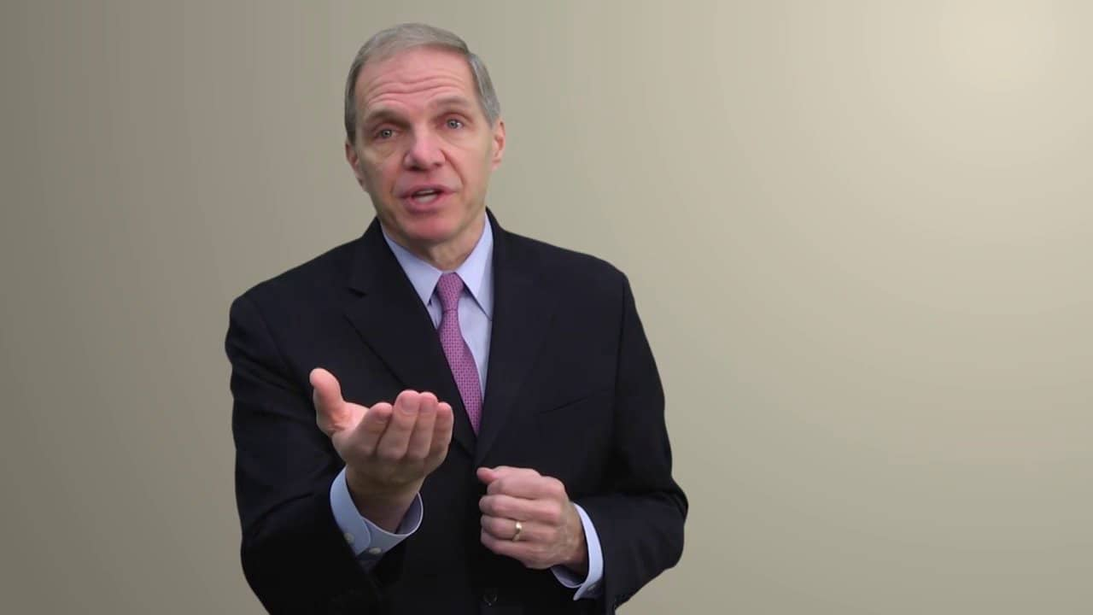
Bishop John Schol will serve two conferences: EPA and GNJ. The Philadelphia Area is still an entity

Slide 6
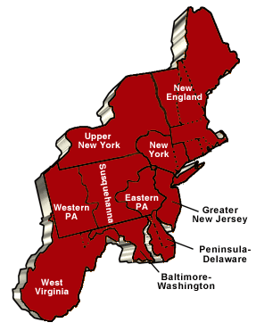
The Northeastern Jurisdictional Conference – Postponed until November 2-4 2022 – No conference in July of 2021 as originally stated

Slide 7
Judicial Council update:s
Involuntary Leaves/retirement paragraph reinstated for a fair process
The JC will not rule on the Constitutionality of the “Protocol”
The Disaffilation Paragraph stays in place and the General Commission on GC has no standing in removing it based on unauthorized ballots cast
Bishops have the right to rule that an ordination is out of order

Slide 8

2021 Session of Annual Conference
Eastern PA Conference

Slide 9
Virtual Annual Conference
May 20-22, 2021 - “Come to the Water”
Thu. May 20 – 9:00 am – 11:00 am – Clergy Session
1:00 pm – 3:00 pm – Laity Session
7:00 pm – Ordination and Commissioning Rehearsal (invitation only)
Fri. May 21 – 9:00 am – 1:00 pm – Annual Conference
2:00 pm – Teaching Session
Sat. May 22 – 10:00 am – Memorial/Communion Service – Olivet UMC (invitation only) Facebook live streamed
2:00 pm – Ordination and Commissioning Service - Olivet UMC (invitation only) Facebook live streamed

Slide 10
More information about Annual Conference (May 20-22, 2021)
We will be having debate and amendments as an option this year
Voting at AC sessions will be done using ZOOM poll. Phone in voting is not an option this year. People need to find a computer or help from their pastor to find a way to connect with a computer. No satellite stations
Facebook streaming is available for all sessions but people cannot vote using Facebook.

Slide 11
Resolutions and business for AC 2021
2022 Budget
Nomination (Clergy and Lay Leadership)
Past Service Rate for retirees in the Pre-82 pension plan (additional payments)
Housing for retirees excluded from gross income
Advance Special designations
Discontinuance of First UMC (Perkasie), Asbury UMC (Norristown)
Distribution of funds acquired from disaffiliations

Slide 12
Speakers at Annual Conference
“Come to the Water”
Rev. Dorlimar Lebron – Elder from the NYAC
Rev. Dr. Jacqui King - Consultant
Dr. Douglas Powe – Wesley Theological Seminary
Bishop Peggy Johnson – Memorial Service
Bishop Mark Webb – Ordination and Commissioning

Slide 13

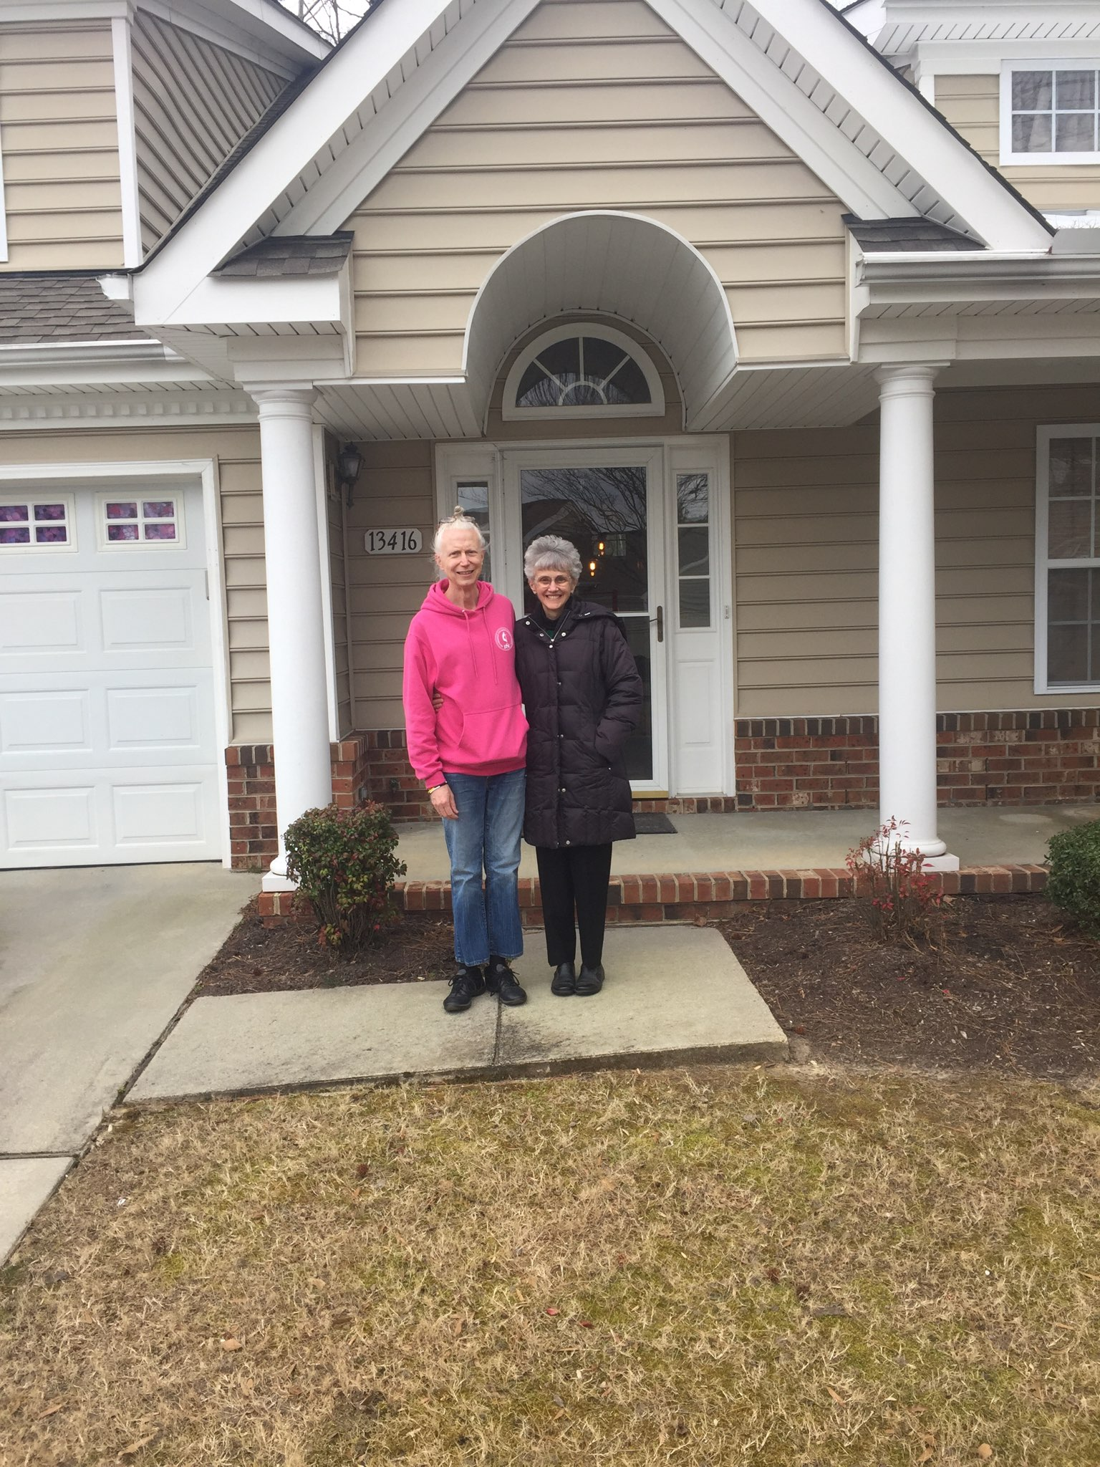
Moving to Carrollton, Virginia

Slide 14
Commitment to Dismantling Racism
Level 1 and 2 regular trainings
CORR – Intercultural trainings to congregations
BOOM yearly training on Intercultural Competency/Bias
Workshops focused on trauma and self-determination
Black Church Summit
Conference-wide book studies on racism issues
Small group studies throughout EPA and Tools for Ministry Program
“Fight for Floyd” studies
CR/CC supports
New plans for Dismantling Institutional Racism (“Living and Being”)

Slide 15

Questions and Closing Prayer

