Slide 1

Town Hall Webinar
Eastern Pennsylvania AC
We will start soon
Enjoy the music!
Bishop Peggy A. Johnson
March 1, 2021

Slide 2

Mr. Dave Koch – Annual Conference Lay Leader

Slide 3
Before we start – Ms. Jo Fielding – Director of
Administrative Services
Put questions in the Q & A and not the chat
This PowerPoint presentation is posted on the EPAUMC.org website and the recording of this webinar will be posted after this evening
After each section of this presentation there will be a time for questions. There are three sections
Not everything is totally decided at this time and when new information is available it will be sent via the website and e-blasts

Slide 4
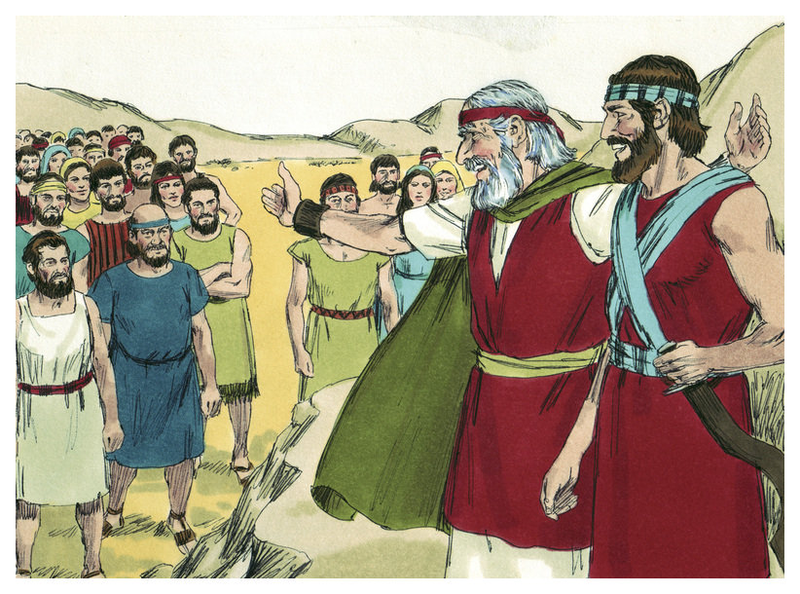
Scripture: Deut. 31:8
Rev. Steve Morton of the Great North District
“The Lord is the one who goes before you. God will be with you and will be faithful to you and will not leave you alone. Do not be afraid or troubled.”

Slide 5
Reminders as we continue on in ministry:
God leads you
God will be faithful to you
God will never leave you
We need not be afraid or troubled

Slide 6

Part One: General Conference
Prayer by Rev. Bumkoo Chung of the Wild West District

Slide 7
News from the COB and the Commission on General Conference
The in-person General Conference 2021 (the postponed 2020 GC) which was scheduled for August 29 – September 7, 2021 in Minneapolis, Minnesota is ALSO being postponed!!
The new date for an in-person General Conference will be August 29 – September 6, 2022 in Minneapolis Minnesota

Slide 8
Why the postponement?
The continuing affects of the Coronavirus and the health hazard of large crowds gathering in one place
The international challenges with COVID, testing required for air travel, and visa uncertainties
The justice issue of full inclusion of our international delegates (44%) if they are not able to come due to the complications of the virus.

Slide 9
What will we do now?
There will be a called Session of General Conference on Saturday, May 8, 2021 (time to be determined) using virtual internet connections
This is a very brief gathering for the purpose of gaining a quorum in order to suspend the rules (a 2/3 vote needed) to allow for voting upon 12 Disciplinary items that will enable denominational business to go forward
A quorum of the 862 delegates is 50% plus one (432 delegates are needed for a quorum)
For a 2/3 vote to suspend the rules, 575 delegates are needed

Slide 10
Who are the Delegates to this May 8th General Conference?
The Delegates to General Conference are those who were elected in 2019 at the last in-person session of Annual Conference
There was a study of the Book of Discipline and although there were some nuances to the Judicial Council rulings regarding GC delegation tenures, there is nothing in the Book of Discipline that deals with this exceptional situation. The COB chancellor and GC parliamentarian affirm the continuation of the 2019 delegates and conferences do not elect new delegates

Slide 11
Eastern PA Conference Delegates elected in 2019 and will be serving
Rev. Dawn Taylor Storm – Clergy
Rev. Lydia Muñoz – Clergy
Rev. Johnson Dodla – Clergy
Rev. Robin Hynicka – Clergy
Ms. Judy Ehninger – Lay (Head of the Delegation)
Krystl Gauld – Lay
Ann Jacob – Lay
Lenora Thompson - Lay

Slide 12
How will voting of the 12 Disciplinary items be handled?
If there is a 2/3 vote to suspend the rules, there will be a motion to utilize paper ballots to act upon the 12 Disciplinary items to become effective upon the announcement of the results of the balloting on Tuesday, July 13, 2021
These votes cast with paper ballots will be “yes” or “no” without debate and mailed in
The May 8th session will explain the 12 items, give rationale for the paper ballot and then adjourn

Slide 13
Why not have a virtual General Conference instead of using paper ballots?
The Commission on GC is charged with “taking the necessary measures to assure full participation of all General Conference delegates (Paragraph 511.4)
The “Technology Study Team” determined that it was not feasible given the variations of connectivity, electricity, translation, and time zone differences in our global church
Full participation could not be guaranteed so the paper option and a very limited agenda was decided by the Commission on General Conference on Feb. 20, 2021
Insights from Rev. Joseph DiPaolo from the Commission

Slide 14
The 12 items to be voted on by paper ballot
#1 – Involuntary leave of absence, involuntary retirement, administrative location or involuntary discontinuance from provisional membership
Members of the Cabinet, Board of Ordained Ministry, Conference Relations Committee and Administrative Review Committee shall not vote in the Clergy Session on recommendations around an involuntary status.
Rationale: separation of powers are set it place for a more fair process.

Slide 15
The 12 items to be voted on by paper ballot
#2 Meetings and Quorum
Allowing the Commission on GC and the COB to “authorize electronic meetings in the future with the understanding that all reasonable means to ensure the opportunity for participation by all delegates in the business of the conference will be used”
Rationale: allowing for electronic voting in the future without having to suspend rules

Slide 16
The 12 items to be voted on by paper ballot
#3 Central Conference issues (those conferences outside of the United States)
This item deals with various matters in the Central Conferences such as the election of bishops, dealing with postponements, using electronic means, etc.
Rationale: allowing electronic meetings of Central Conferences and giving direction and parameters for these gatherings

Slide 17
The 12 items to be voted on by paper ballot
#4 – Assignment date for bishops in the US
In the US the assignment for all bishops shall be no later than 60 days following the adjournment of the jurisdictional conference
Rationale: it used to say “September 1” in the BOD. That needs to be more flexible given that unforeseen circumstances can arise

Slide 18
The 12 items to be voted on by paper ballot
#5 – Mandatory Retirement of Bishops
Mandatory retirement: 60 days following the adjournment of a regular or special session of Jurisdictional Conference if the bishop’s 68th birthday has been reached on or before July 1. The Central Conference bishops (outside the US) have one year following the adjournment of the regular or special session of the Central Conference. All bishops at the age of 72 will be automatically retired 60 days after their 72nd birthday. (Central Conference bishops at 72 still have the possibility of a special assigned arrangement)

Slide 19
The 12 items to be voted on by paper ballot
#6 - Voluntary Retirement of Bishops
Any bishop who attains the age and/or number of years of service may upon their own request and with approval of the College of Bishops and the Jurisdictional Committee on Episcopacy be granted the retired relationship. They can also retire ad interim.
Rationale: - Retirement would be based on age and adjournment of regular or special session of Jurisdictional or Central Conference.

Slide 20
The 12 items to be voted on by paper ballot
#7 and #8 – Budgets for the General Church
#7 – affirms the role of GCFA to write the budget but in the event of a postponed GC the budget approved at the last quadrennial session shall be extended
#8 – affirms the process of budgeting. Actual receipts for each fund for the quadrennium shall be the basis for all budgeting procedures. If the regular session of GC is postponed the last quadrennial session’s budget shall be extended.

Slide 21
12 Items to be voted on by paper ballot
# 9 – Election of Secretary and Statistician
#10 – Election of Conference Treasurer/Director of Administrative Services
#11 – Conference Board of Ordained Ministry
#12 – Conference Committee on Episcopacy
If there is a postponed General Conference the conference can elect and put in place a new slate following the date originally scheduled for the regular session of General Conference.
Rationale: These allow for annual conferences to put new people in place if there is a postponement in the future.

Slide 22
Why not vote on the Separation of the Denomination at this virtual meeting?
It is the widespread belief that the delicate deliberations around issues of separation, which inevitably will involve extensive debate and amendments, cannot be conducted with integrity and full participation of each delegate in an online format. It will need to wait until the next in-person General Conference in 2022.

Slide 23
Preparations and Process for this Special Session of General Conference
April 2-9 – Sample Ballots and Explanatory notes are sent to translators and prepared for release, videos and presentations are created
April 26-30 – Regularly Scheduled Council of Bishops Meeting
May 8 – Special Session of General Conference (virtual)
May 14 – Ballots and explanatory notes are sent to each General Conference delegate
July 13 – Announcement of the results of the paper balloting on the 12 items

Slide 24

Questions about General Conference

Slide 25

Part Two – Annual Conference 2021
Prayer by Rev. Evelyn Kent Clark of the Super South District

Slide 26
Virtual Annual Conference
May 20-22, 2021 – Rev. Dawn Taylor Storm - DCM
“Come to the Water”
Thu. May 20 – 9:00 am – 11:00 am – Clergy Session
1:00 pm – 3:00 pm – Laity Session
7:00 pm – Ordination and Commissioning Rehearsal (invitation only)
Fri. May 21 – 9:00 am – 1:00 pm – Annual Conference
2 pm – Teaching Session
Sat. May 22 – 10:00 am – Memorial/Communion Service – Olivet UMC (invitation only) Facebook live streamed
2:00 pm – Ordination and Commissioning Service - Olivet UMC (invitation only) Facebook live streamed

Slide 27
More information about Annual Conference (May 20-22, 2021)
Resolutions are due Friday, March 5, 2021
Voting the Rules of Order - Sunday, April 18, 2021 at 3:00 pm, followed by separate District Conferences at 4:00 pm
Google-Drive available for suggestions
We will be having debate and amendments as an option this year
Voting at AC sessions will be done using ZOOM poll. Phone in voting is not an option this year. People without computer access can use satellite stations

Slide 28
Speakers at Annual Conference
“Come to the Water”
Rev. Dorlimar Lebron – Elder from the NYAC
Rev. Dr. Jacqui King - Consultant
Dr. Douglas Powe – Wesley Theological Seminary
Bishop Peggy Johnson – Memorial Service
Bishop Mark Webb – Ordination and Commissioning

Slide 29

Questions about Annual Conference?

Slide 30
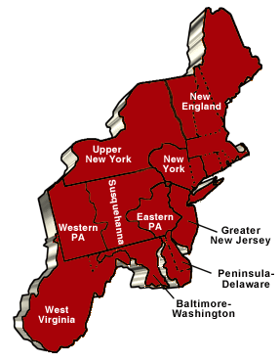
Part Three: Northeastern Jurisdictional Conference
Prayer by Rev. Dr. Andrew L. Foster III from the
Excellence-Focused East District

Slide 31
Regular Session of the Northeastern Jurisdictional Conference
The week of July 19th (sometime between July 20 & 23) – Virtual meeting. There will be no November 8-12, 2021 NEJ Conference
Bishops who are retiring will be officially voted: Bishops Jeremiah Park, Sudarshana Devadhar & Peggy Johnson
Announcements of realignments and assignments of bishops
Determine if or how many bishops will be elected at the next in-person meeting (that date has not been determined but it will not be in 2021)
Budget conversations
There will be no election of members of boards and agencies. Those currently serving will continue on until the next in-person JC

Slide 32
Why can’t we Elect Bishops at this virtual meeting of the NEJ in July?
The necessary interviews, vetting, voting and consecration of newly elected bishops cannot be done properly in an online format at a regular session of the Jurisdictional Conference. This reality will necessitate each College of Bishops in collaboration with the Jurisdictional Committee on Episcopacy to provide a plan for coverage of the episcopal areas until such time as elections can take place if the individual jurisdiction decides to do so. In the places where elections are determined to be necessary, meetings will need to take place simultaneously in accordance with the provisions stated in the Book of Discipline.
We may choose not to elect in the NEJ until there are more retirements for financial and demographic reasons and continue with 6 bishops a while longer. That has not been decided.

Slide 33
Clergy Delegates to the Virtual NEJ Conference – July 20-23, 2021
Rev. Dawn Taylor-Storm
Rev. Lydia Muñoz
Rev. Johnson Dodla
Rev. Robin Hynicka
Rev. Dan Lebo
Rev. Edward Cameron
Rev. Hannah Bonner
Rev. Dr. Christopher Kurien

Slide 34
Lay Delegates to the Virtual NEJ
Conference – July 20-23, 2021
Ms. Judy Ehninger (Head of the Delegation)
Ms. Krystl Gauld
Ms. Ann Jacob
Ms. Lenora Thompson
Mr. David Koch
Ms. Clarita Krall
Ms. Elizabeth Fisher
Mr. Matthew Calderone

Slide 35
Alternates to the Virtual NEJ Conference July 20-23, 2021
Rev. Mandy Miller
Rev. Monica Guepet
Ms. Kristine Adams
Ms. Susan Grimm Mattox
Alternates step in if a delegate cannot participate in the order of their election

Slide 36
Engagement of New Assignments/Alignments
New Assignments begin September 1, 2021
Central Conferences (outside the US) will meet on a different schedule depending on the action of General Conference and potential COVID-10 related restrictions or delays
Pen-Del and Baltimore-Washington have already been slated to be aligned beginning in September. The decision about who the Eastern PA Conference will be aligned with has not yet been decided and will likely not be known until the NEJ Conference in July

Slide 37
Alignment and not Merger
Alignment means two conferences are served by the same bishop. Just as Eastern PA partners with the Peninsula-Delaware Conference on various events, training opportunities and mission collaboration, EPA’s new partner conference will be in like manner
There will not be changes in boundaries or mergers happening at this time

Slide 38
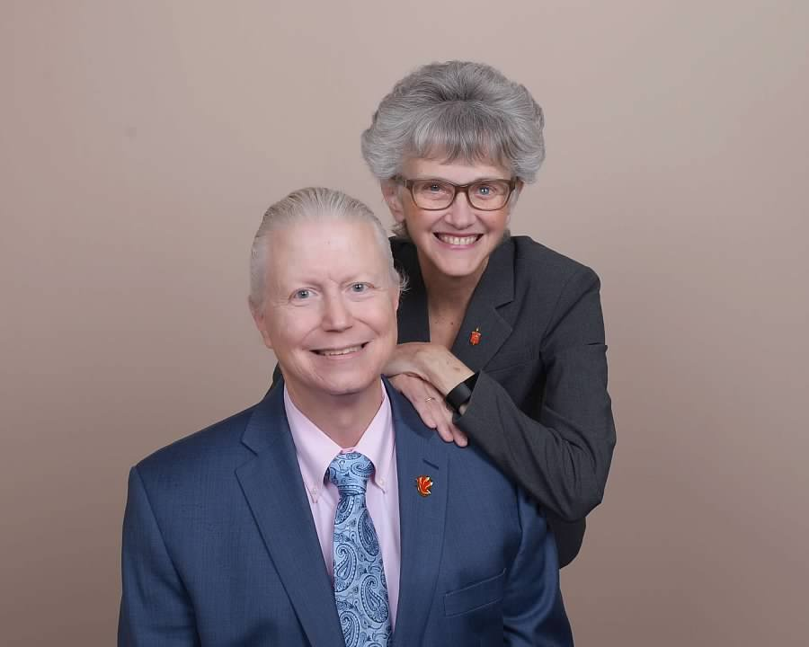
Retirement of Bishop Peggy Johnson by
Dawn Taylor-Storm
Bishop Peggy A. Johnson is requesting voluntary retirement effective September 1, 2021 after 13 years serving the Philadelphia Area
Her mandatory retirement is 2024 but due to the limited number of years remaining it was her prayerful discernment to retire this year and not accept a new appointment
She and her husband Rev. Michael Johnson will move to Carrollton, Virginia near their oldest son and his family
Ministry will continue in some new ways!!
The Johnsons thank the Eastern Pennsylvania
Annual Conference for their love and grace

Slide 39

Questions about Northeastern Jurisdictional Conference?

Slide 40

Closing Prayer – Mr. James Brown, Conference Treasurer

