Slide 1

Safe Sanctuaries
Updated May 2023
Notes:
Good (morning, afternoon, evening).
Welcome to Safe Sanctuaries training. My name is (insert name) and (provide your background and why you are conducting the training).
This training is intended to provide churches the necessary information and actions to ensure safe ministry with those under 18 years of age.
This training is not intended to provide a full and complete training on the complexities of safe sanctuaries and how to implement safe sanctuaries in a local church, but to provide to provide the framework necessary to have a compliant safe sanctuaries policy.
Regarding any inaccuracies:
At the time this presentation was created all information presented was the current understanding of the safe sanctuaries committee of current state and federal laws.

Slide 2

Churches are meant to be sanctuaries.
A safe harbor where all people can feel protected.
It provides for the protection of the whole person, which includes the physical, emotional, spiritual, mental,
and relational wellbeing of each person.
Churches express
the presence of Christ
Notes:
Read from the slide.

Slide 3
Safe Sanctuary - a policy and guidelines developed to protect our vulnerable persons in order to make our congregation a safe place where everyone may experience the abiding love of God and fellowship within the community of faith. This includes children’s check in/out procedures, training and background checks for those working with vulnerable persons, and procedures that guide the interaction of children, youth and adults.
Notes:
Read from the slide.

Slide 4
Reasons We Have
Safe Sanctuaries Policies
More than 600,000 children are abused in the U.S each year. An estimated 618,000 children (unique incidents) were victims of abuse and neglect in 2020, the most recent year for which there is national data.
Girls had a victimization rate of 8.9, higher than boys at 7.9. American-Indian or Alaska Native children have the highest rate of victimization at 15.5 while African-American children have the second highest-rate at 13.2.
Most child victims are abused by a parent. In 2020, a reported 483,285 perpetrators abused or neglected a child. In substantiated child abuse cases, 77% of children were victimized by a parent.
Notes:
Statistics are according to the National Childrens’ Alliance website.

Slide 5
Abuse, including neglect and exploitation, is experienced by about 1 in 10 people aged 60 and older who live at home. From 2002 to 2016, more than 643,000 older adults were treated in the emergency department for nonfatal assaults and over 19,000 homicides occurred. Some groups have higher rates of abuse than others.
Notes:
www.cdc.gov/violenceprevention/elderabuse/fastfact.html

Slide 6
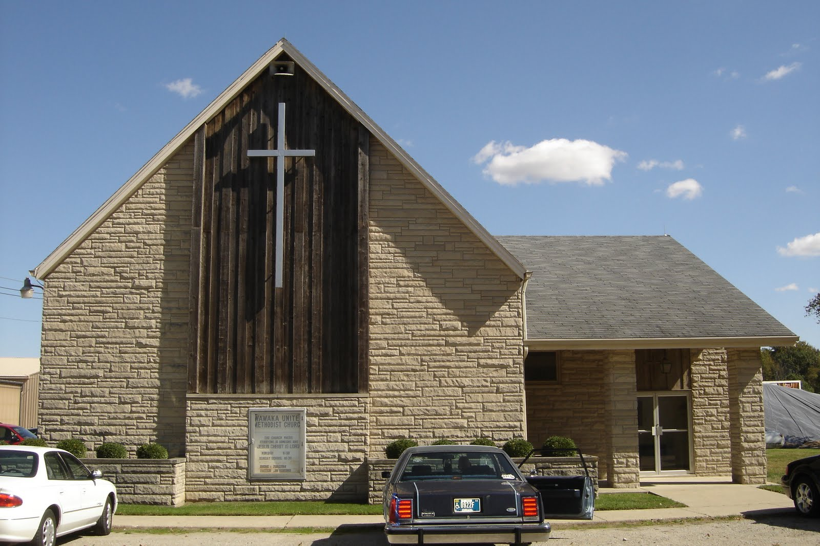
Churches strive to be free from intimidation, exploitation, abuse and harassment. In a Safe Sanctuaries Church, we find security, compassion, support, guidance and the presence of God.
The "Social Principles" in the Book of Discipline are explicit about protecting our children:
“In particular, children must be protected from economic, physical, emotional and sexual exploitation and abuse.”
- BOD 2016 ¶162.C p121
Notes:
Read from the slide.

Slide 7
Why We Use Safe Sanctuaries Policies
A Safe Sanctuaries Policy spells out in writing the covenant between church leaders and members. It provides clear steps for action and reporting abuse by those within the congregation. It helps us protect and serve our congregations in their homes, schools and workplaces when we suspect something is not as it should be.
We pray that we never need to implement the steps laid out in our Safe Sanctuaries policies, but when an incident occurs or a situation of abuse/neglect concerns us, the policy gives us clear direction and steps to follow which minimize anxiety and guide us to take the necessary legal action and provide appropriate pastoral care.
Notes:
Above from the New England conference of the UMC

Slide 8

Every Eastern Pennsylvania Annual Conference Church
MUST HAVE a Safe Sanctuaries policy in place regardless of whether or not the church has children participating.
It is the policy of the Eastern Pennsylvania Conference that every church in the conference adopt a Safe Sanctuaries policy that conforms to the standards set forth in this conference policy. It is the policy of the Eastern Pennsylvania Conference that all conference and district ministries with children comply with the standards set forth in this policy.
Notes:
Read from the slide.
Stress that Eastern PA Conference voted in 2008 to create our safe sanctuaries policy and follow the PA law.
At the 2023 annual conference the policy was updated.

Slide 9
Notwithstanding anything contained in this policy, it is the responsibility of every church in the conference to ensure that it is in compliance with all aspects of the Pennsylvania Child Protective Services Law (23 PA. C.S.A. 6301) which can be found at the time of this writing at https://www.legis.state.pa.us/CFDOCS/LEGIS/LI/consCheck.cfm?txtType=HTM&ttl=23&div=00.&chpt=063.&CFID=246217912&CFTOKEN=44782272. In the event that the law conflicts with this policy, the law shall control.

Slide 10
Safe Sanctuaries Policy Logistics
What the policy says
  (EPA policy can be used as a template)
Where policy is kept
How often it is updated
How it can be referenced
Notes:
Read from the slide.

Slide 11
Records Management
Churches or Church Preschools should have assigned a Safe Sanctuaries Administrator and a secure record keeping system for forms, background checks, “need to renew” dates, etc.

Slide 12
Record Keeping
Records: all written records shall be confidential and shall be kept in a secure location with access restricted on a need-to-know basis, to the Pastor, SPRC chair and/or Ministry Lead. All files (clearances, reference checks, training attendance, letters of recommendations from prior church, etc.) shall be maintained for thirty (30) years after ministry ends with the individuals. Files can be digitized and kept in a permanent online secure environment.
Notes:
Read from slide
For Volunteers
Applies to ALL ADULTS responsible for welfare of children AND any having direct contact with children – this is broader than before.
Allows not obtaining FBI for persons who have lived in PA during entire past 10 years.
Stress that regardless if the lived in the state for the last 10 years they need to
Affirm in writing they have not been convicted in any other state of any of the Pennsylvania offenses that prohibit service.

Slide 13
Screening Standards
All applicants for employment and/or volunteer service in which that applicant shall have contact with children in a manner which, under Pennsylvania law currently in force and as enacted and amended in the future from time to time, requires the person to obtain background clearances shall complete the following prior to start of service:
Written Application
Background Checks
References
Relationship to church
Notes:
Written Application: a written application that shall include at least the following, but not limited to, information:
Name
Address
Phone Number (cell and/or home)
Email Address
Work/Volunteer History
Experience and skills related to the position
Two (2) personal, non-related references.
Disclosure that they have been informed of and will comply with Pennsylvania law that requires them to inform the church in writing of any arrest, conviction or child abuse report that would prohibit them from working with children. (23 Pa.C.S.A. 6344.3(g)(1))
Background Checks:
All background checks (PA criminal record background, Child Line check, and FBI clearance) required by the laws of the Commonwealth of Pennsylvania currently in force and as enacted and amended from time to time which can be found at the time of this writing at https://www.dhs.pa.gov/KeepKidsSafe/Clearances/Pages/default.aspx will be conducted for all employees and volunteers. The current law at the time of this writing is that a minimum of every 60 months (5 years) clearances from the date the of the first clearance are required to be resubmitted. In the case of FBI clearances, an affidavit can be submitted if the person has been a resident of PA for at least 10 years. This can be found under Disclosure Statements at https://www.dhs.pa.gov/KeepKidsSafe/Clearances/Pages/default.aspx
(Every five years both will be conducted for all employees and volunteers.)
References: at least two references from persons not related to the applicant shall be obtained and contacted for all new applicants for employment or volunteer service.
Relationship with Church: all prospective volunteer workers with children shall have an active relationship with the local church for at least six months before being allowed to be in a supervisory role in activities for children; or twenty-four months of good standing at their previous church. (Documented by the Pastor with a letter from the previous church.)

Slide 14
Background Checks
  Background Checks –
  a. All background checks required by the laws of the Commonwealth of Pennsylvania currently in force and as enacted and amended from time to time.
  b. In addition to the above clearances, all employees and volunteers of the EPA conference camps shall obtain all clearances required for Camp Association.
  c. In addition to the above clearances, all employees and volunteers of the preschool centers operated by an EPA church shall obtain all clearances required for their certificate of compliance by the Department of Education.
Notes:
All background checks must be updated every 5 years.
FBI printing is to be done for all PAID employees, regardless of years of residency in state.
FBI printing is not required for VOLUNTEERS if they have resided in the same state for 10 consecutive years or more; however, an affidavit must be signed to comply with the requirements.
There are codes on the EPA website to obtain for paid employees and all links to the forms are on the site as well.
FBI fingerprint waiver affidavit [PDF] – A form to waive the FBI fingerprinting requirement if they have lived in PA consecutively for the past 10 years and hasn’t been convicted outside PA of an offense that would disqualify them from working with children and youth as well as vulnerable and older adults.

Slide 15
Obtaining Clearances
https://www.epaumc.org/safe-sanctuaries/
https://www.epaumc.org/safe-sanctuaries/safe-sanctuaries-selection-screening/
Apply for Clearances Online: Child Abuse History Clearance
PA State Criminal Record Check Online
FBI Fingerprinting & Criminal History Report
  Under "Enter your Service Code to get started:"
    Employees enter 1KG756
    Volunteers enter 1KG6ZJ

Slide 16
How Often Is Safe Sanctuaries
Training Needed?
TRAINING:
All persons who have direct contact with children shall participate in training as required under the laws of the Commonwealth of Pennsylvania currently in force and as enacted and amended in the future from time to time which can be found at the time of this writing at https://www.dhs.pa.gov/KeepKidsSafe/Pages/Trainings.aspx.
Initial safe sanctuaries training for anyone new to working with children or youth shall occur and at a minimum covers reviewing and agreeing to this policy and the local church’s specific policy. This training should occur prior to a person working with children or youth. Every year, some type of review training shall occur.
Those working as ministry leads are to be fully trained and fully cleared before working with any children or youth. Assistants who are not ever placed in charge of the ministry can be in process for training but need to have all clearances before working with children and youth. Training must occur within the first month of working with children and youth for any assistant.
Notes:
Also applies to vulnerable and older adults.

Slide 17
Policy Requirements
Supervision
“Two Adult” Rule. There will be at least 2 unrelated adults in each activity. If this is not possible, there will be a roving person who moves amid the rooms during the program period with at least one (1) certified individual in each room.
Additional adults may be require depending on the nature of the activity (i.e., off-site trips).
All activities must occur in open view. Classroom windows may not be covered.
No child will be left unsupervised.
Age difference needs to be at least 5 years difference.
Transportation involves written consents from parent or guardians.

Slide 18
Supervision Best Practices
Registration materials must be collected for all activities and permission forms for transportation.
Recommended ratios for off-site trips are 1 to 8 for children up through and including age 11 and 1 to 10 for ages 12 through 17 years of age.
18-24 year old individuals can supervise younger children if they are at least 5 YEARS OLDER than the children they are supervising.
Volunteer helpers ages 14-17 may only work under a trained and certified adult.
“Putting children in charge of children invites disaster.”
Joy Melton. “Safe Sanctuaries.” Nashville: Discipleship Resources, 1998. page 32

Slide 19
Parental Supervision Responsibilities –
Best Practices
It is the responsibility of a parent to supervise when a child/children are not in an organized activity.
Children grades 5 and younger should be escorted to and from an activity.
If a different person is to pick up the child/ children from an activity, notify the program or activity director.
Program and Activity Directors – do not release a child to anyone not designated to pick up that child.

Slide 20
Child Abuse – Pennsylvania Laws
  Intentionally, knowingly, or recklessly:
  Causing bodily injury.
  Causing or substantially contributing to serious mental injury.
  Causing sexual abuse or exploitation.
  Causing serious physical neglect.
  Creating a reasonable likelihood of bodily injury or sexual abuse or exploitation.
Changes to the Law as of January 1, 2015
Notes:
Read from the slide.
Add that the law has changed and this is the law that will take into effect on January 1, 2015. We intentionally have provided the major wordsmithing of the changes listed in red as what is the most important changes. Please remember the fact is regardless of the changes we need to know it and abide by it.

Slide 21
Signs of Abuse
Signs are not always crystal clear.
Some children show no outward signs of physical or sexual abuse.
General rule: If you notice a sudden change in a child’s behavior and that behavioral change is sustained over time, it’s worth looking into.

Slide 22
Possible Signs of Physical Abuse Indicators
Burns, bruises or cuts in unusual areas, such as the soles of feet, palms of hands, back, abdomen, face, neck, back of arms or legs.
Multiple burns, bruises or cuts in various stages of healing.
Glove-shaped burns on the hands or sock-shaped burns on the feet from being forced to bathe in scalding water.

Slide 23
More Possible Signs of Physical Abuse Indicators
Adult-sized bite marks.
Unexplained fractures.
Conflicting or changing stories about how injury occurred.
Delayed or inappropriate treatment of an injury.

Slide 24
Possible Signs of Sexual Abuse Indicators
Reluctance to be left alone with a particular person
Wearing lots of clothes, especially to bed
Fear of touch
Drawings that show genitals
Abuse of animals
Age-inappropriate sexual play with self, others, pets, or toys
Physical indicators of sexual abuse, if present, are usually temporary but may include: Difficulty in walking, Torn, stained or bloody underwear, Genital pain or itching

Slide 25
Reporting Child Abuse
Suspected Child Abuse MUST be reported to the Pennsylvania Child Abuse Hotline (24 hour/7 day service) call 800-932-0313
(Post this number throughout your building.)

Slide 26
Reporting Procedures
Reporting of an allegation is required by law whenever there is “reasonable cause to suspect”.
Reasonable cause includes:
1. Any staff or volunteer who has personally witnessed an incident of abuse.
2. An allegation of an incident of abuse is made to an employee or volunteer.
3. A child/youth/vulnerable adult discloses abuse to an employee or volunteer.

Slide 27
Reporting Procedures
It is crucial that reporting be immediate and dealt with within 48 hours. The Witness is considered the Mandatory Reporter by law and must contact the Abuse Hotline DIRECTLY.
When abuse is reported, the suspected person(s) should immediately be removed from contact with children and youth.
Complete the “Report of Suspected Abuse Incident”.

Slide 28
Reporting Procedures
If the accused is clergy, the witness is considered the Mandatory Reporter and must immediately report the abuse DIRECTLY to the Abuse Hotline.
Then the witness must contact the Chairperson of the Staff-Parish Committee who will in turn notify the District Superintendent and the Bishop.
After the above appropriate reporting the witness is to keep the allegation confidential.

Slide 29

DO NOT DELAY
A mandated reporter who fails or delays reporting could be charged with a misdemeanor or a felony, depending on whether the non-reporting is willful and how serious the abuse is.
Reporting Procedures
Notes:
Read from the slide.
Note that the change here is immediately. There is no longer a 24-48 hour window. The law doesn’t define immediately, it needs to be done as soon as reasonably possible. What you want to avoid is any appearance of delay.

Slide 30

Compliance
Compliance with this policy is a matter of record at each annual Charge Conference.
Notes:
Read from slide.

Slide 31

Welcome to the Virtual World – yes, even in church
Notes:
Cyber Safety includes all social media and includes texting and email.
Safety issues can happen when inappropriate expectations and boundaries are created. A balance is needed in how and what topics can be discussed and shared electronically with children, youth and vulnerable adults.
Each local church needs to consider how cyber safety is part of their safe sanctuaries policy.

Slide 32


Slide 33




        Keeping our children safe with technology use
        means having parents and volunteers in the know.
        So many devices
Notes:
Read from the slide.
Stress that cyber safety is something that can be overlooked easily.

Slide 34
For better or worse, social media has become an intrinsic part of adolescence. A majority of teens use YouTube (95%), TikTok (67%), Instagram (62%) and Snapchat (59%), according to a Pew Research Center survey of American teenagers ages 13 to 17.
A survey of 1,316 teenagers aged 13-17 in the US reveals that 97% now use the internet every day, up from 92% in 2014-15. However, the Pew Research Center’s most striking finding is perhaps that 46% say they use the internet “almost constantly” – a significant rise from 24% in 2014-15.
Notes:
According to Fox News
According to World Economic Forum

Slide 35
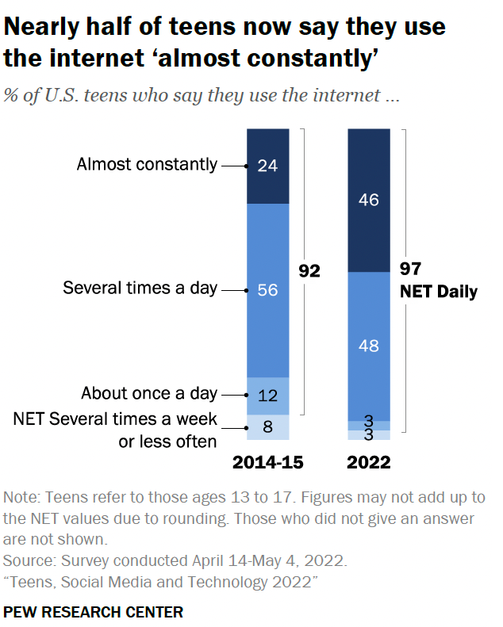

Slide 36
Black and Hispanic teenagers use the internet more than their white peers, with 55-56% saying they are online almost constantly, compared with 37% of white teenagers, the survey found. The researchers say this trend is consistent with previous research.
Older and urban teenagers of all races and backgrounds are also more likely to be online. And just over half of teens from households earning $30,000-74,999 a year say they use the internet nearly all the time, compared with 43% of those in households making at least $75,000.

Slide 37
Kids and teens in America are spending more time than ever using screens and social media, with the number of hours spent online having risen sharply during the pandemic, according to results from a survey released Wednesday.
The survey, published by the nonprofit research organization Common Sense Media, found that overall screen use among teens and tweens increased by 17 percent from 2019 to 2021 — growing more rapidly than in the four years prior. On average, daily screen use went up among tweens (ages 8 to 12) to five hours and 33 minutes from four hours and 44 minutes, and to eight hours and 39 minutes from seven hours and 22 minutes for teens (ages 13 to 18).
Notes:
New York Times article

Slide 38
The increases reported by the survey are most likely a reflection of the difficulties that families endured with school, childcare and social interaction throughout the pandemic, experts said. Of particular concern to some who track screen time is an upswing in social media use among children ages 8 to 12, on platforms such as Instagram, Snapchat and Facebook, even though such platforms require users to be at least 13 because of a law that prohibits companies from collecting data from children.

Slide 39
Recognize developing brains may be especially vulnerable to specific social media features. 2. Monitor and discuss your child’s social media use.
2. Monitor and discuss your child’s social media use.
3. Model healthy social media use.
4. Watch for problematic social media use.
5. Teach social media literacy.

Slide 40
"Sexting" involves the sending of nude or sexually suggestive images electronically, whether through text messaging, social media, chat boards, or email. Sexting has become especially common among teenagers—many of whom are minors—and can easily be used to bully or harass.
Notes:
Nolo

Slide 41
In 2012, Pennsylvania enacted a law prohibiting the sexting of "sexually explicit images" by minors younger than 18. Sexually explicit images include those involving nudity or depicting a minor's genitals, pubic area, breast, or buttocks in a sexual manner.
Minors whose actions fall under the teen sexting law face misdemeanor penalties, rather than the harsher felony penalties under the child pornography laws.

Slide 42
Child Pornography and Obscenity Laws
Adults—including teenagers age 18 and 19—who sext with minors or take nude photos of minors can face felony charges under Pennsylvania's child pornography and obscenity laws. Depending on the situation, a minor (younger than 18) can also be charged with these offenses, such as when sexting involves images of minors engaged in sexual acts or sexually explicit images of children younger than 12.

Slide 43
Child Pornography
Pennsylvania's child pornography laws (called sexual abuse of children) apply when a person knowingly:
photographs, records, or films a child (younger than 18) engaging in a prohibited "sexual act" (sexual intercourse, oral or anal sex, masturbation, or lewd exhibition of the genitals)
causes or permits a child to engage in a prohibited sexual act for the purpose of being filmed, recorded, or photographed, or
sells, transmits, or shares images of a child engaged in a prohibited sexual act.
It is also a crime for a person to intentionally view or knowingly possess child pornography.

Slide 44
What Can We Do at the Church?
Here are the top five best practices to apply our safe sanctuaries policy to the virtual world.
  Still use the two-adult rule so that there is NEVER one-on-one contact. At no time should one adult be holding any one-on-one conversations with any youth without other adults knowing there are conversations occurring. In addition, online meetings need to begin with two adults, not from the same family, and then allowing youth to join.
Still use all selection, screening and training policies. In the virtual world and space, it may feel right to let new volunteers that are untrained and lack clearances to lead discussions. Any online discussion should be considered no different than a face-to-face meeting. Volunteers need to be screened and trained before taking on leadership roles.
Notes:
Read from the slide.
How the internet is accessed in your church. Is it through your network?
Use BCC when sending large massive emails to many individuals. Some people may not want their email shared. If those under 18 are on the list, it is even more important to use the BCC function. Add a section on your release forms for children and youth if emails may be used. Be judicious when working with church groups that have those under 18 and sharing emails.
Clarify the following
No identifiable information on church electronic media such as the church website, Facebook, Twitter -OR- hard copy forms like
This is intended to ensure no photos are posted identifying information on any social media platform of the local church
USE the Waiting Room feature on ZOOM to allow participants to enter after 2 or more are waiting.

Slide 45
Use “ministry-based” on-line platform accounts instead of personal accounts. This means the local church should own the on-line account with access by several church leaders and/or staff so there is accountability of meetings.
Maintain the same communication with parents and youth about meetings including times and links to access the meeting. This way everyone knows what is going on. With younger children, under sixth grade, syllabus and activities should be shared with parents or caretakers prior to online meetings so everyone is transparent as to what is occurring. For children sixth through twelfth grade, leaders should provide parents and caretakers with the same outlines of meetings and topics that are typical for your youth group with more transparency being utilized than less.

Slide 46
If your current release forms do not give you permission for picture/video sharing either get them updated or do not share pictures/videos of virtual meetings. This includes tagging your youth in the virtual environment. If you do not have permission do not post and tag them.

Slide 47
What Can We Do at the Church?
Get permission from Parents and/or Guardians of both children and teenagers to apprehend their cellphones, if necessary.
Always be on the look out for any type of cellphone activity that looks suspicious.
If abuse is divulged electronically, follow standard abuse reporting procedures. If you are the witness of this electronic abuse, you are considered the Mandated Reporter by law and must report this DIRECTLY to the hotline.
Notes:
Read from the slide.
The important issue is that if the abuse is divulged electronically, it is considered the same as if you saw it or was told about it. Therefore, as a mandated reporter you need to follow the policies already discussed.

Slide 48

Church Computer Use
Have ALL church staff and volunteers who have access to church computers sign an agreement to follow a Technology Use Policy.
(There is a sample on the conference website)
Notes:
Read from the slide.
Provide handout.

Slide 49
Address: Berks County Children & Youth Services Berks County Services Center 11th Floor 633 Court Street Reading, PA 19601 Phone: 610-478-6700 FAX: 610-478-6799 E-mail: bccys@countyofberks.com ** 24-hour on call services for emergencies ** This e-mail address is not intended for the purpose of reports of child abuse or neglect. ** Any information regarding the abuse or neglect of a Berks County child should be reported at (610) 478-6700 OR to the state CHILDLINE office at 1-800-932-0313
Contact information for your County
Notes:
Post your county’s information

Slide 50
RECAP for your Church
Remember : Many forms/templates are under Resources – “Safe Sanctuaries” section of the EPA Website
Audit your existing Safe Sanctuary Policy, Permission Slips, Media Release Forms, etc. for Compliance
Once Initial Training for Staff and Volunteers is completed, an Annual Review (not Training) must take place
Your church might consider a formal Non-Disclosure Agreement (NDA) for personnel handling clearances.

Slide 51
RECAP for your Church
Ensure that compliance records are kept in a
secured place within the church office.
Have forms available for:
clearances/covenants/volunteer applications
Abuse Phone numbers posted

Slide 52

Questions & Answers

