Slide 1
Otterbein at 250 –
1771-2021
Seeking a “True Spiritual Life”

Slide 2
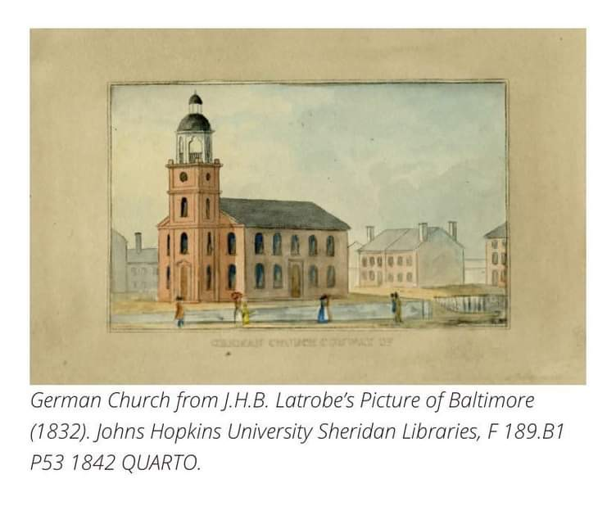
“German Church on Conway”
Early 1800s image
Notes:
German Church from J.H.B. Latrobe’s Picture of Baltimore (1832) Johns Hopkins University Sheridan Libraries.

Slide 3
250th Anniversary Celebration Website oldotterbeinumc250.org
Recorded worship and Niemann organ concert
Link to register for Sunday worship

Slide 4
Become a member
Friends of Old Otterbein
$20 INDIVIDUAL FRIEND
$25 FAMILY OF FRIENDS
$100 INSTITUTIONAL FRIEND
FOR MEMBERSHIP INFORMATION: otterbeinat250@gmail.com

Slide 5
For more information:
Rev. Cynthia H. Burkert, Retired Elder and
250th Anniversary Co-Chair cindyburkert216@gmail.com
Mr. Daniel Fisher, President,
Friends of Old Otterbein danielbfisher@me.com

