Slide 1


Discipleship, Leadership and Congregational Health Survey
August 2021

Slide 2

Overview
The review team did not identify any significant statistical difference when it segregated the results by the different demographic data points.
Participation
Total participation: 506
  GNJ: 225 (44.4%)
  EPA: 281 (55.5%)
  Clergy: 290 (57.65%)
  Laity: 213 (42.35%)
CHURCH SIZES
RACE/ ETHNICITY:
SETTING:
Under 50, 42.26%
51-100, 29.37%
101-150, 9.72%
151-200, 9.13%
201-300, 5.56%
301-400, 1.98%
401-500, 0.60%
500+, 1.39%
White, 75.10%
AA/ Black, 6.92%
Asian, 2.57%
Nav Am, 0.00%
Hispanic, 2.77%
Mid-Eastern, 0.20%
Pac Isl, 0.20%
Mixed Races, 12.25%
Urban, 14.91%
Rural, 21.47%
Town, 27.44%
Suburban, 36.18%

Slide 3
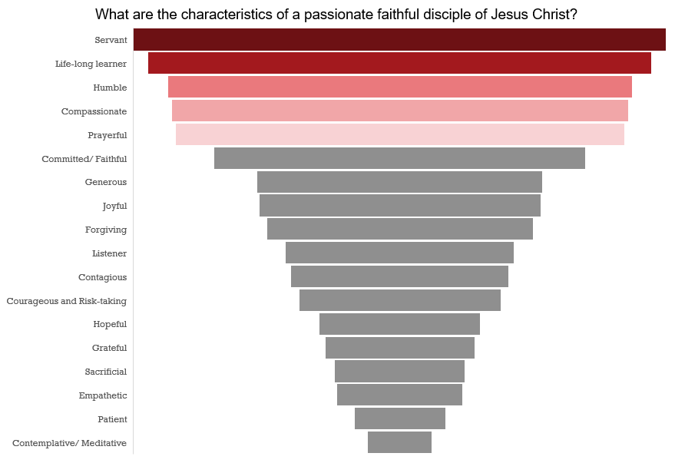
Characteristics of a Disciple of Jesus Christ - ALL ANSWERS

Slide 4
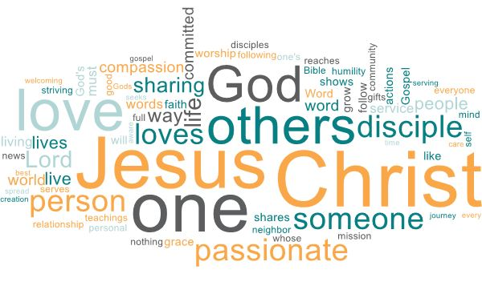
Characteristics of disciples of Jesus Christ
(World Cloud from the open- ended question)

Slide 5
Characteristics of disciples of Jesus Christ
(Open ended question)
When given a chance to put it in their own words (approximately 450 responses to each open-ended question), survey responders said this:
Passionate Disciples (Questions # 6) are completely in love with God and have a deep love for all people. Their personal relationship with Jesus Christ directs all that they do and is something they are quick to speak about. The Holy Spirit works through them. (Though none of the responses was specifically Trinitarian, corporately: it’s all there!) A commitment to spiritual disciplines is evident; frequently mentioned was Bible Study, corporate worship, and prayer. Service to community is a high priority, sometimes referred to as “justice” ministries. They seek continual spiritual and intellectual growth: lifelong learners, pursuing obedience to the Word. Compassion and generosity characterized these persons, as well as a commitment to risk for the sake of Christ (aware of the cost of discipleship.)
Several summary comments about Passionate Disciples:
Seek the kingdom of God above all else, following the footsteps of Jesus
Love of God and sacrificial love of neighbor (as Jesus instructed)
Service and Justice ministries

Slide 6
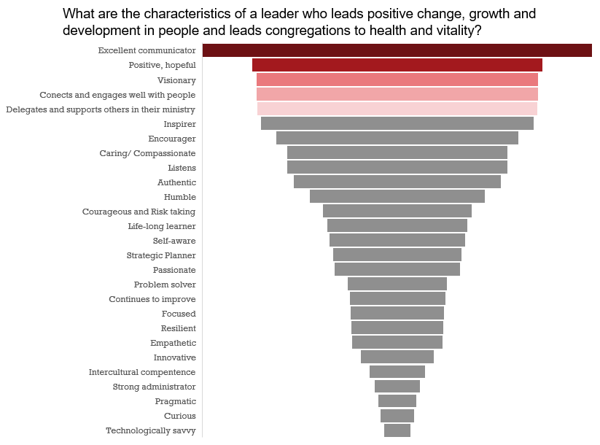
Characteristics of a Transformational Leader – ALL ANSWERS

Slide 7
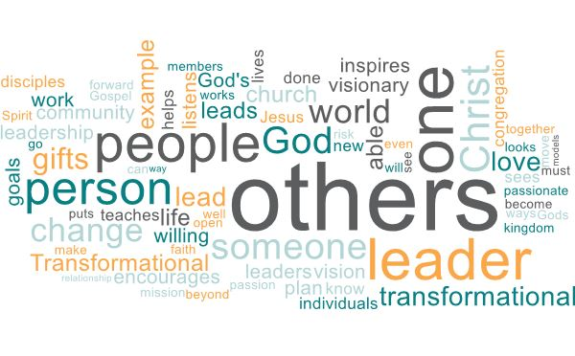
Characteristics of a leader
(World Cloud from the open- ended question)

Slide 8
Characteristics of a leader
(Open ended question)
When given a chance to put it in their own words (approximately 450 responses to each open-ended question), survey responders said this:
Transformational Leaders (Question #8) are spiritually-grounded, Spirit-led. They have a clear vision for the congregation, and they communicate it often & well. Personal integrity (character) is critical: they are reliable role models (she practices what she preaches). Mobilizing the people for action is as important as the action itself: employing the gifts of the congregation and the development of teams. They operate out of a servant mindset. Key qualities include humility, industry (hard work), relational skills, and enthusiasm. They are excellent listeners, not afraid of change, well-organized, and committed to lifelong learning.
Several summary comments about Transformational Leaders:
Presents a compelling vision and gets folks excited, moving in that direction
One who encourages others, leads by example, and provides direction
Able to discern the gifts & talents of the people, and bring those to maturity in the kingdom
Engenders a desire in others to become passionate disciples
Someone who keeps their eye on the prize, whose commitment & vision excite others to share the goal, and who can project-manage (or delegate) to assure success

Slide 9
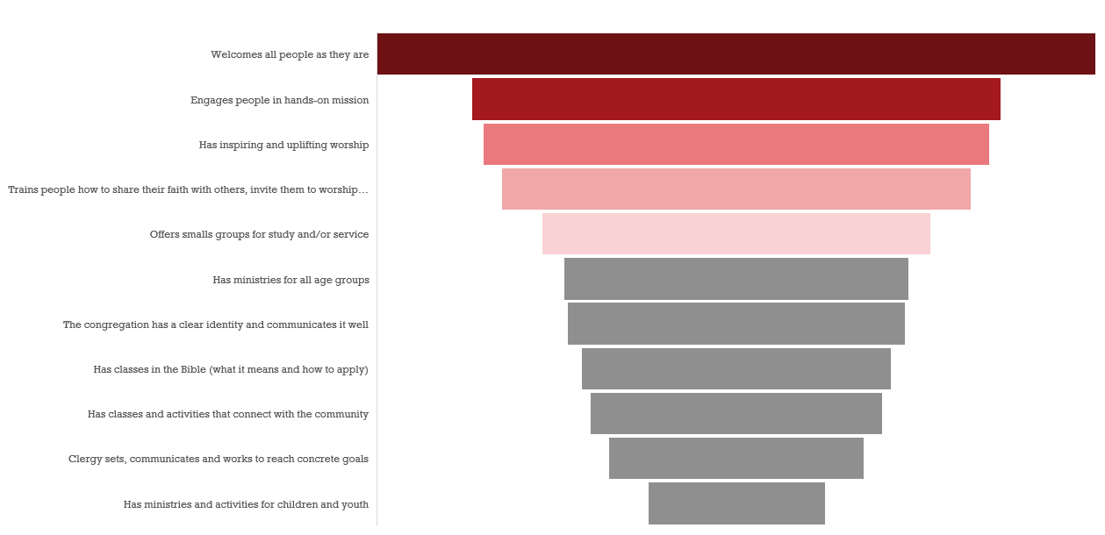
Characteristics of a Healthy Congregation

Slide 10
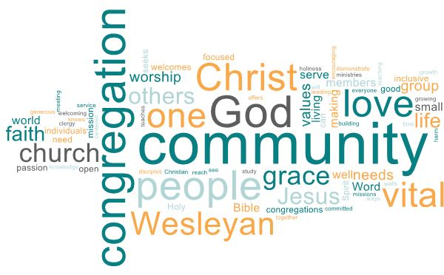
Characteristics of a Healthy Congregation
(From the open- ended question)

Slide 11
Characteristics of a Healthy Congregation
(Open ended question)
When given a chance to put it in their own words (approximately 450 responses to each open-ended question), survey responders said this:
Vital Wesleyan Congregations (Question # 10) demonstrate a commitment to welcoming all of God’s people. Inspirational worship centers all that they do, enhanced by weeklong opportunities for spiritual formation in small group gatherings. Participants look to the holy scriptures for guidance and comfort. Community ministry & service to others is the heartbeat of the people.
Several summary comments about Vital Congregations:
Equal commitment to personal and social holiness
Grace-filled, does no harm, does good, stays in love with God
Loves & serves Christ, each other, the community and world
The people “go and do” rather than “sit and listen”

Slide 12
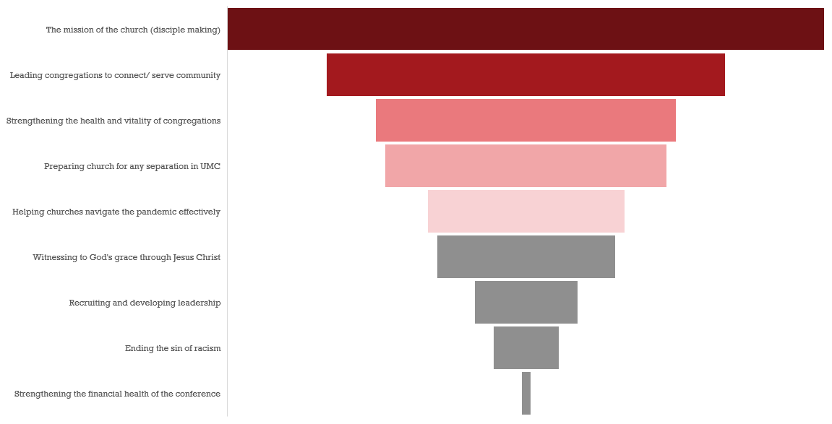
What should be the Bishop’s and Leadership Focus

