Slide 1
10 Things you need to know about the CARES ACT Paycheck Protection Program Loan (PPP)

Slide 2
1. We are sharing information we learned this past week from INJOY, Church Fuel, Vanderbloemen, and Horizon Stewardship.

Slide 3
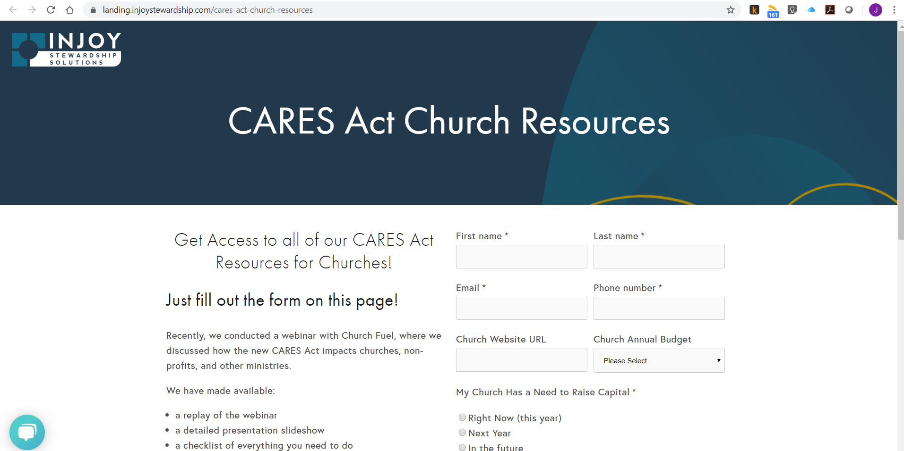

Slide 6
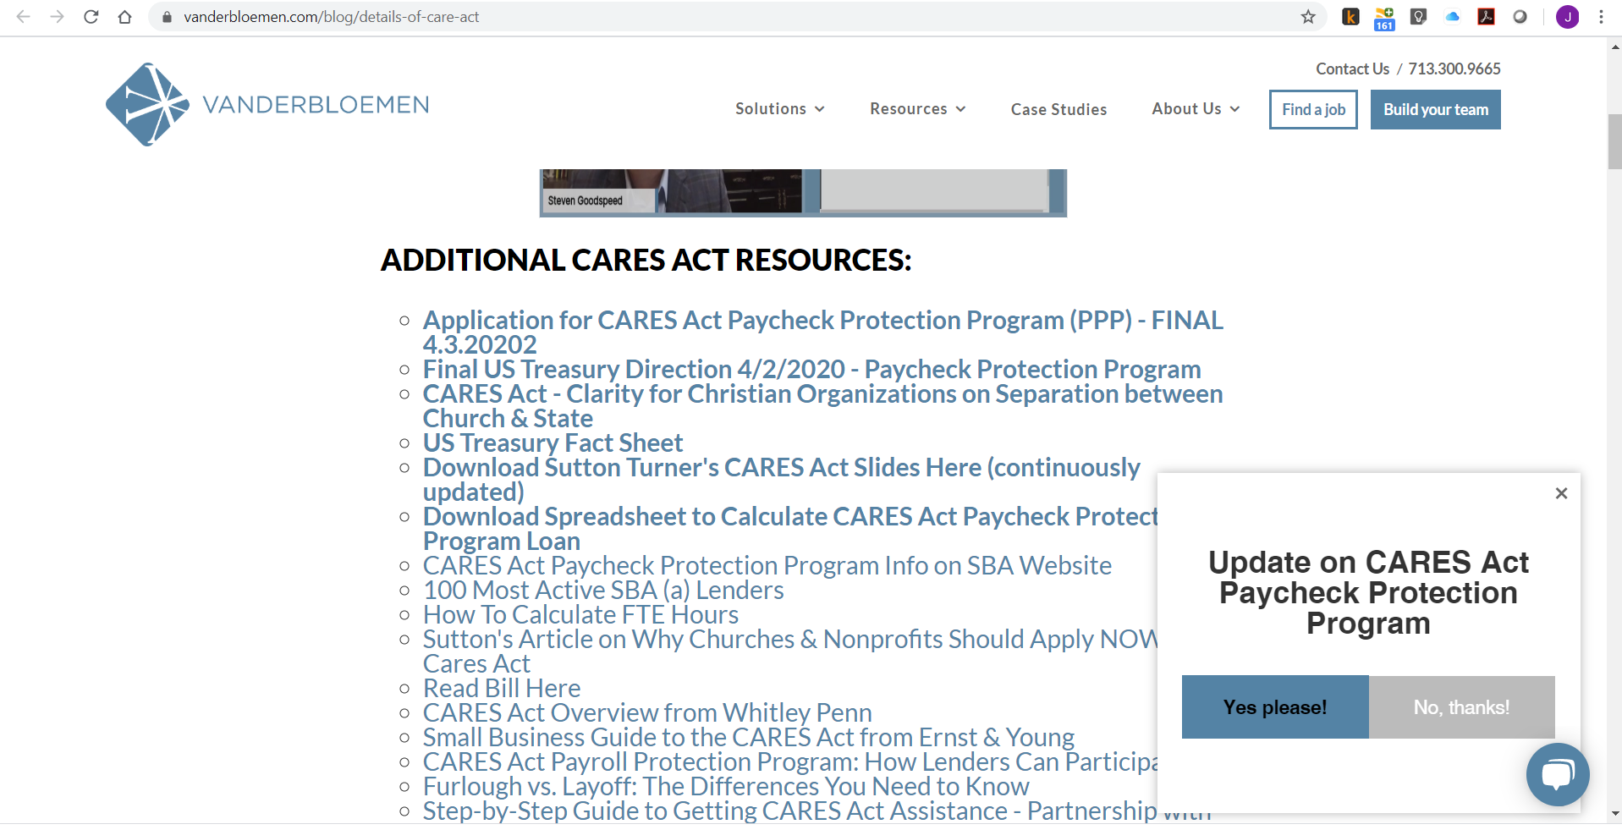

Slide 7
2. Churches and non-profits are eligible to apply for a PPP Loan. The purpose of the program is to help small businesses to not layoff any employees.

Slide 8
3. The PPP Loan should be forgiven if the church:
Doesn’t lay anyone off during the 8-week period.
Has actual expenses

Slide 9
4. How much can you apply to receive? 2.5 times the 2019 monthly avg expenses of (A+B+C+D) A = compensation paid to employees B = health insurance paid on behalf of employees C = housing allowance paid to pastors D = pension payments made on behalf of emp

Slide 10
5. You have a limited amount of time to apply. The money is being loaned on a first come basis until it is all gone.

Slide 11
6. The application process is handled by your local bank. See the SBA website for a list of lenders
Completed Application
Proof of payroll payments

Slide 12
7. Your church council needs to approve this action on a preliminary basis, and you will need to have it formally approved at a specially called charge conference.
Request permission from your DS to hold a special charge conference for this purpose.
Announce the Charge Conference to your church at least 10-days in advance of the vote.
Have an approved Ordained Elder conduct the CC.
Record the minutes and send a copy to the DS.

Slide 13
8. If you want to apply for a PPP loan:
start preparing for required church approval.
Locate a small business administration approved lender. Let them know you would like to apply for a PPP loan. Ask for an application and any supporting information they will need from you.
Consult your legal, tax, and accounting advisors to ensure you set up the proper procedures and internal controls to ensure you are eligible to have the loan forgiven later.

Slide 14
9. Documents you may need to provide:
Month end payroll reports by employee from Jan 1, 2019 to most current month in 2020.
Report by each pay date, by employee, for Feb 2019 and Feb 2020
Quarterly 941 reports for all quarters of 2019
Annual 940 report for 2019
Employee related costs for health insurance
Retirement plan funding for Jan 1, 2019 to current

Slide 15
10. The PPP Loan application is only two pages
Supporting documents will need to be provided to your lender
The application form must be signed by a trustee Name, Trustee

