Slide 1
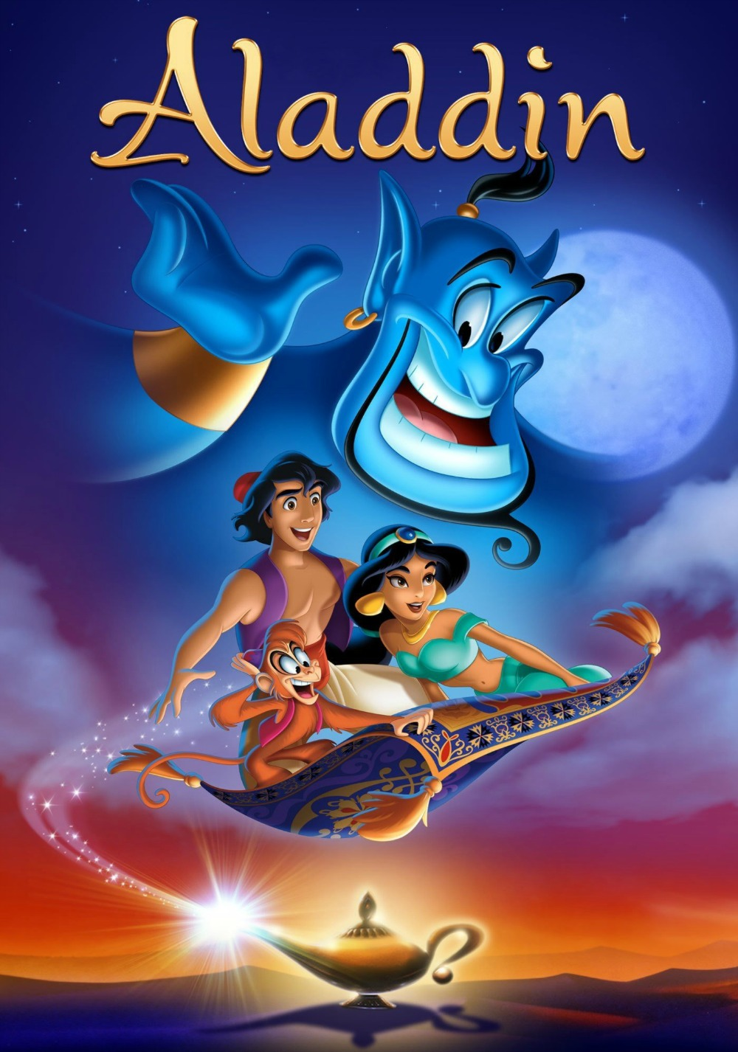
“I Won’t go Speechless!”
Bishop Peggy A. Johnson
Gretna glen Camp – November 17, 2019

Slide 2
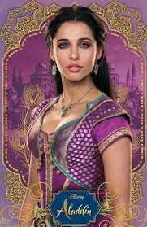
Jasmine’s Song from “Aladdin”
“I won’t be silenced
You can’t keep me quiet
Won’t tremble when you try it
All I know is I won’t go
Speechless
Speechless!!”

Slide 3
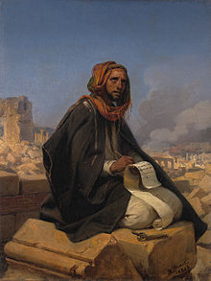
Young Prophet Jeremiah:
“If say, ‘I will not mention him,
or speak any more in his name,’
there is in my heart as it were a burning fire, shut up in my bones, and I am weary with holding it in and I cannot.” Jeremiah 20:9

Slide 4

Young people of faith can speak out for justice and for people who have no voice!

Slide 5
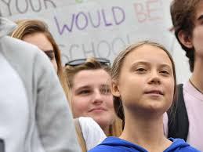
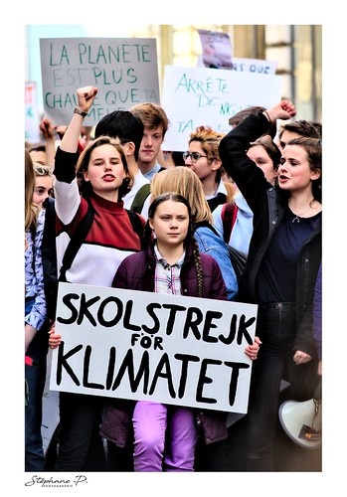
Gretna Thunberg: The Environment

Slide 6
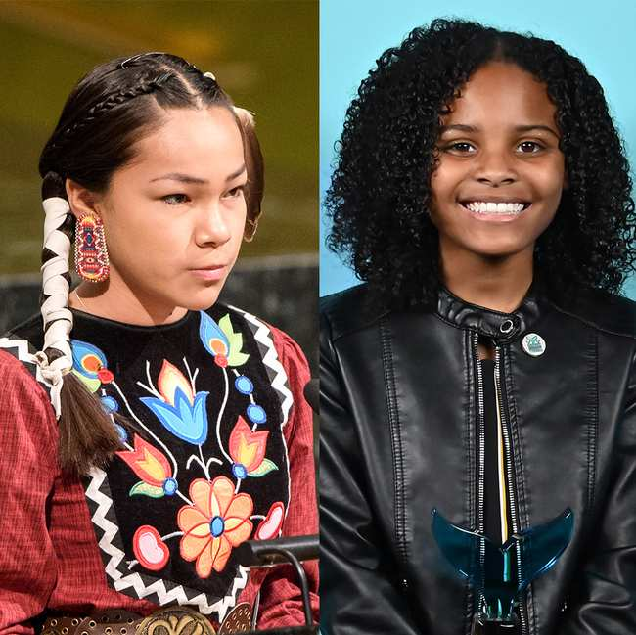
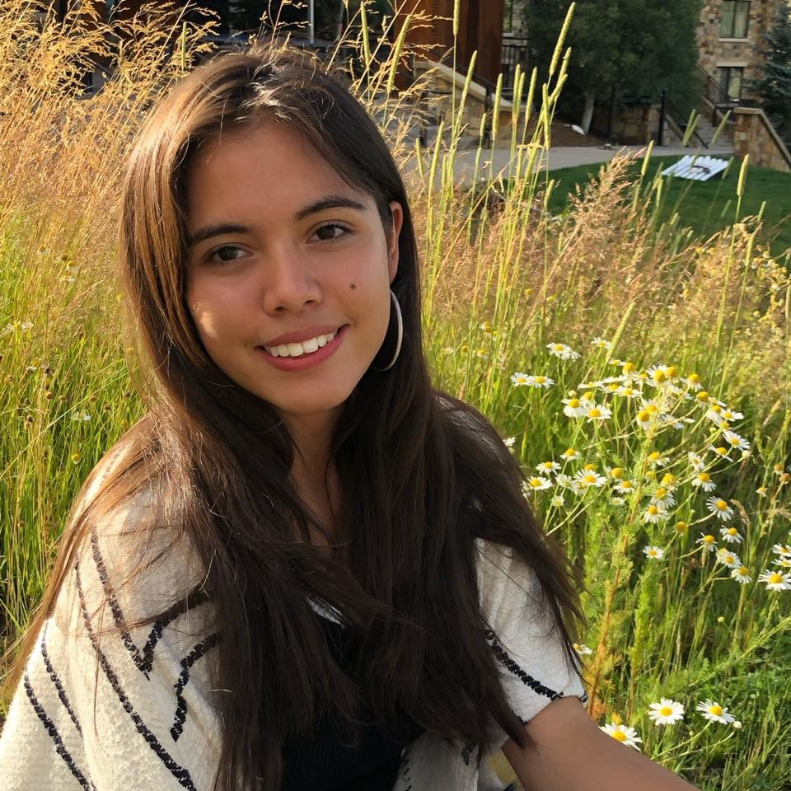
Water Activists: Autumn Peltier, Mari Copeny, Xiye Batida

Slide 7
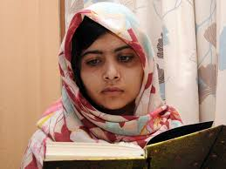
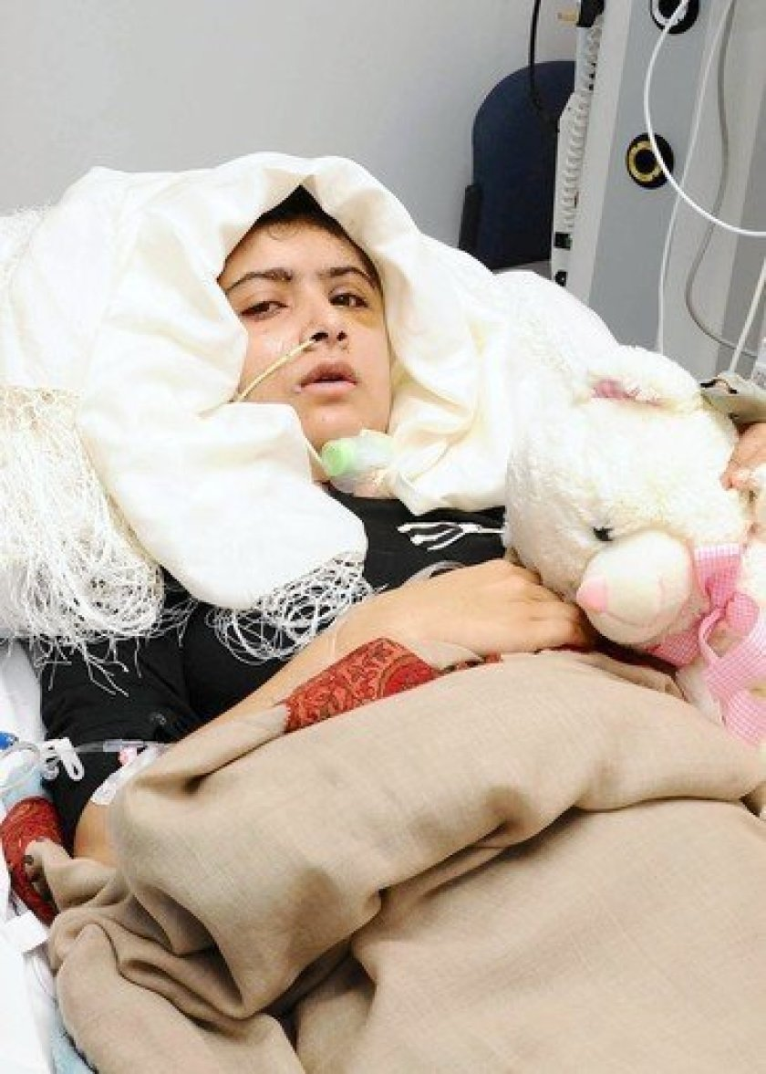
Malala Yousafzai: Education of Girls

Slide 8
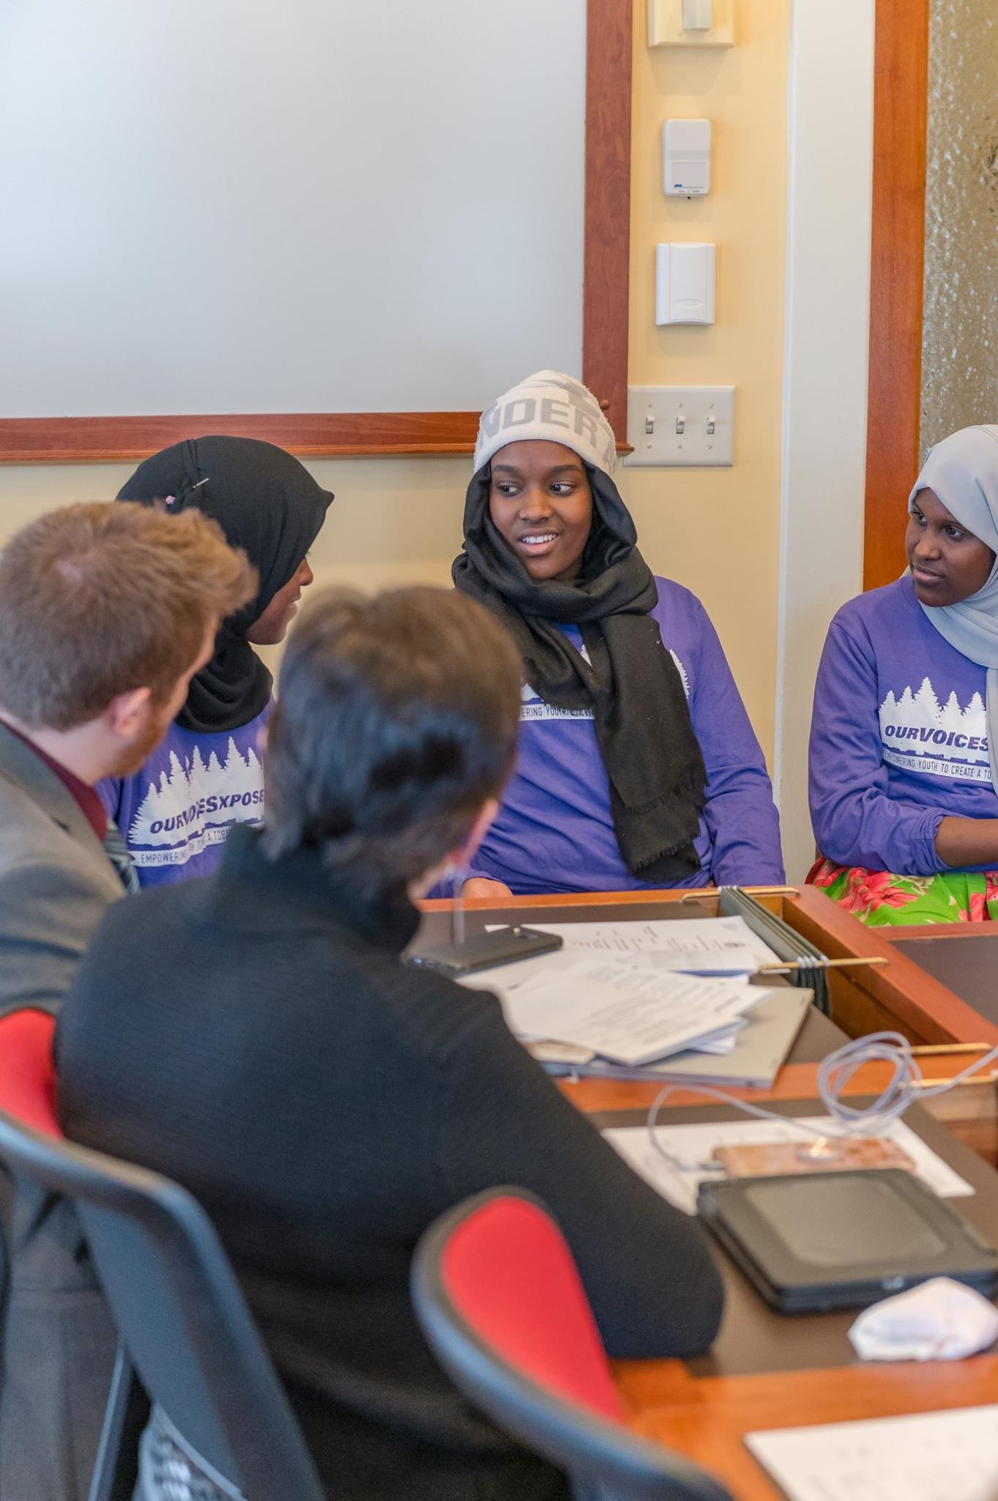
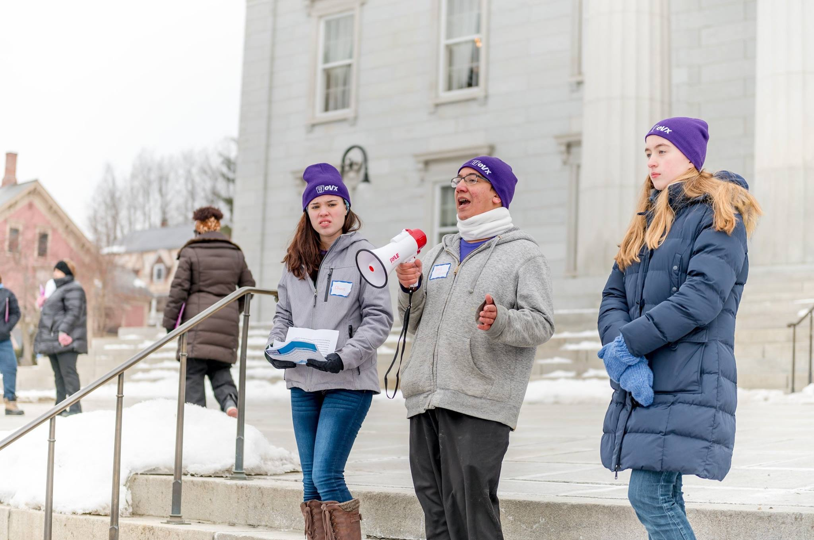
“Our Voices Exposed” Speaking out against Vaping

Slide 9
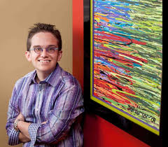

Jeff Hanson: Disability Awareness and Philanthropy

Slide 10
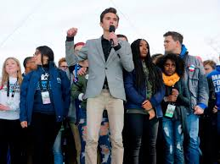
Parkland School Activists

Slide 11

Where do you see injustice and wrong in this world?
Bullying?
Discrimination?
Economic injustice?
Cruelty?
Hurt?
Pain?
Sadness?

Slide 12
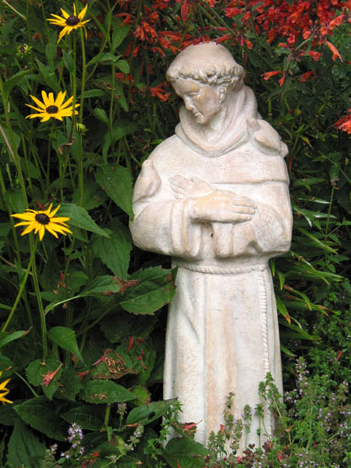
St. Francis once prayed….
“Lord, make me an instrument of your peace. Where there is hatred, let me sow love, where there is injury, pardon, where there is doubt, faith; where
there is despair, hope; where there
is darkness, light and where there
is sadness, joy.”

Slide 13
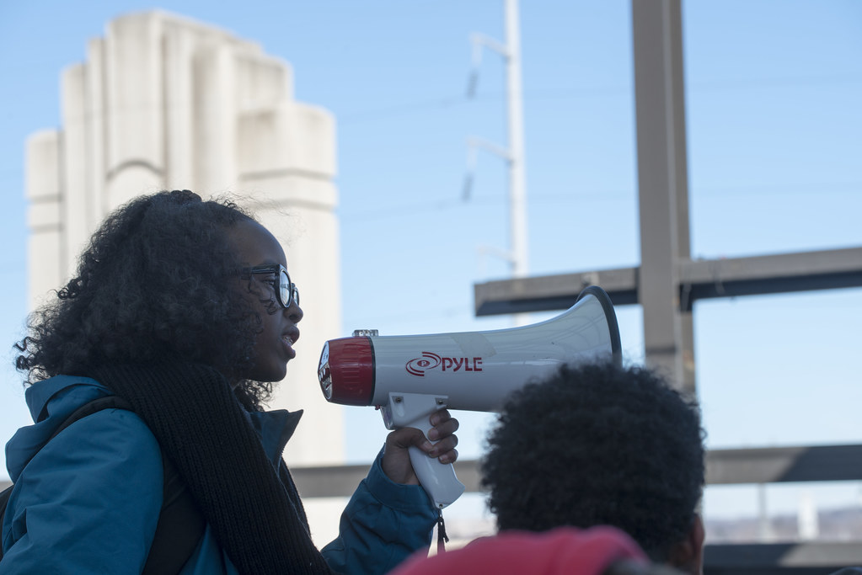
Sometimes that means: speaking out!

Slide 14
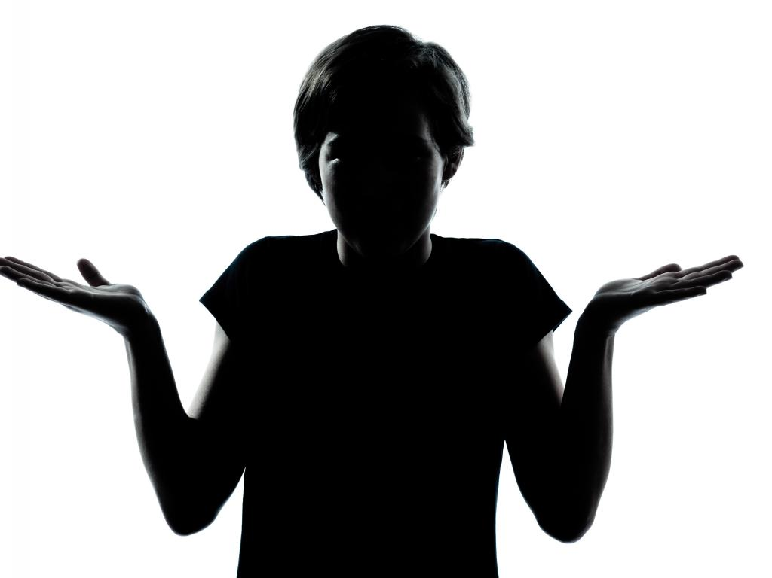
Joe Vineyard (age 17) from St. Johnsbury Academy in VT:
“The worst thing is not to do anything.”

Slide 15
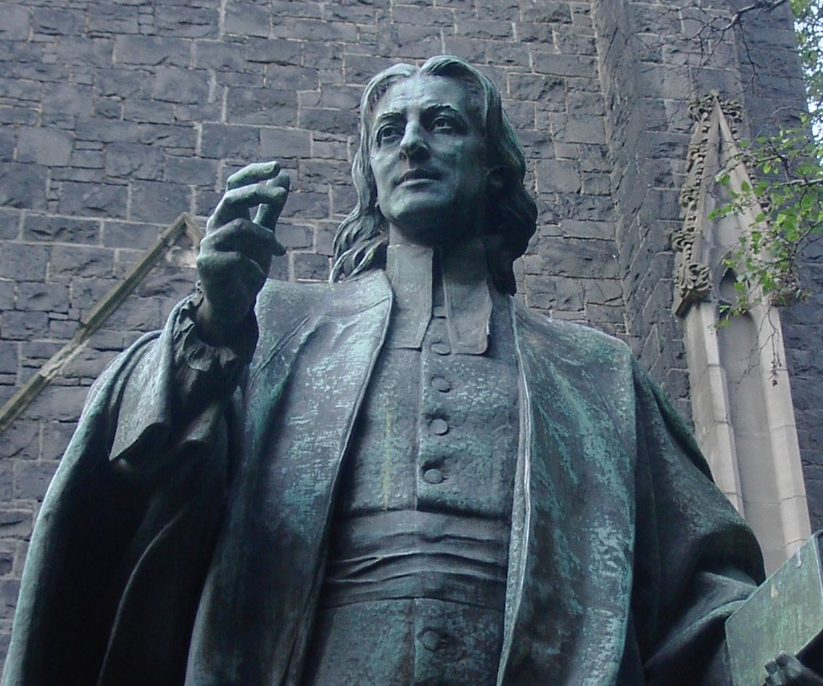
What is God calling you to do?
John Wesley says:
“Do all the good you can
By all the means you can
In all the ways you can
In all the places you can
At all the times you can
To all the people you can
As long as ever you can”

Slide 16
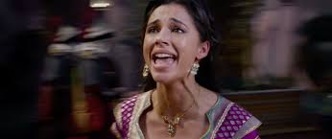
Don’t be “Speechless!!”

