Slide 1
DISTRICT MEETING “COMMUNITY OUTREACH”
Bishop Peggy A. Johnson
Eastern Pennsylvania Annual Conference
Fall 2019

Slide 2
DEVOTIONS
ACTS 1: 7-8, 12-14

Slide 3
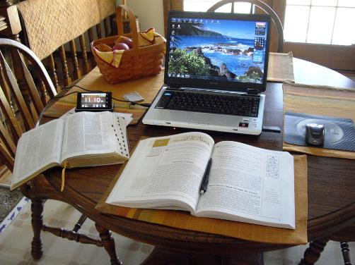
COMMUNITY OUTREACH
It needs to start with an intentional discipleship plan using the disciplines of faith driving the process

Slide 6
SURVEY THE NEEDS OF YOUR COMMUNITY
Housing
needs
Faith Communities
Institutions
and
Businesses
Food
needs
Schools

Slide 7
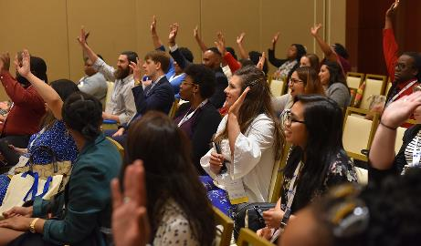
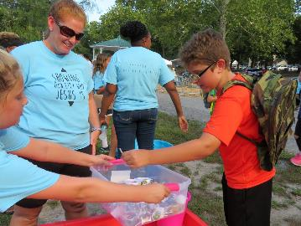
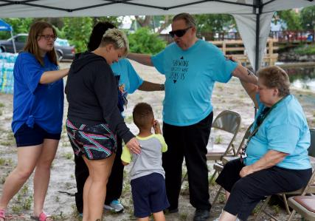
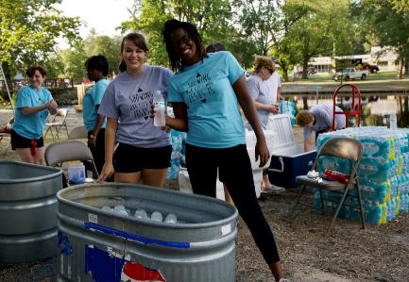
ATTEND COMMUNITY MEETINGS AND EVENTS

Slide 8
WALK THE STREETS AND PRAY

Slide 9
LEARN ABOUT THE INSTITUTIONS AND BUSINESSES

Slide 10
GET TO KNOW COMMUNITY LEADERS AND RESOURCES

Slide 11
CONNECT WITH FAITH COMMUNITIES

Slide 12
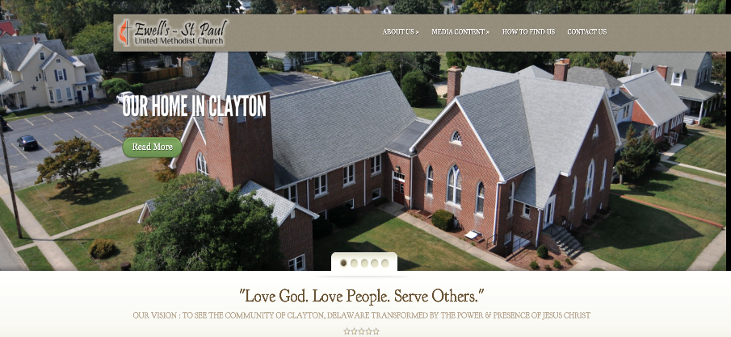
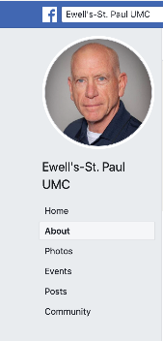
BE VISIBLE ON THE INTERNET!
Have an accessible website
and Facebook page

Slide 13
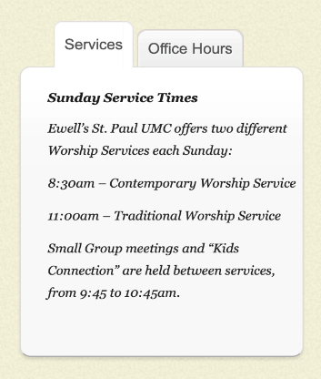
The times of services and programs should be easy to see

Slide 14
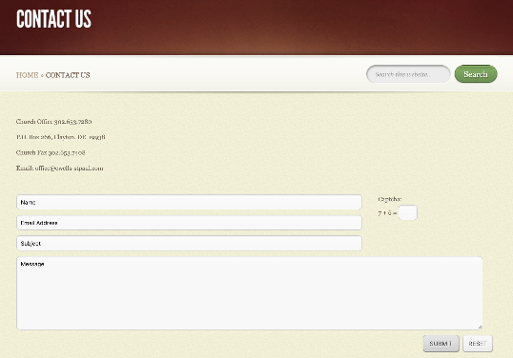
Make sure people can contact the church on this site

Slide 15
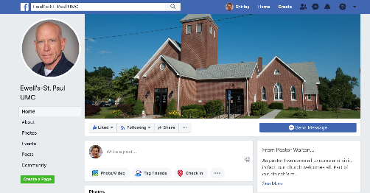
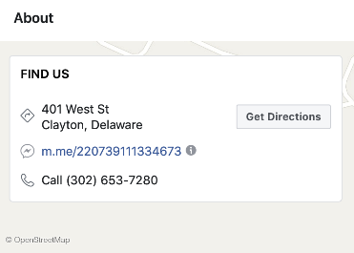
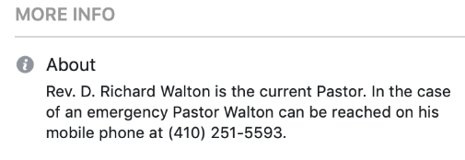
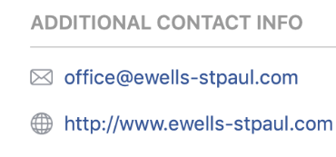
Pastors should not be hiding their names and contact information

Slide 16
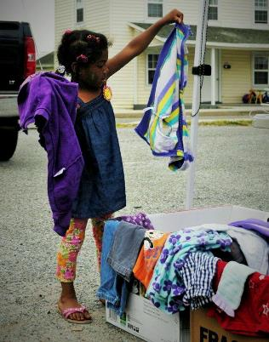
THERE IS NO END TO THE POSSIBILITIES WHEN YOU GET OUT INTO THE COMMUNITY

Slide 17
SOME CREATIVE IDEAS

Slide 18
BLOCK PARTIES

Slide 19
FOOD DISTRIBUTION

Slide 20
HOME OWNER’S CLASSES
The “KEY”
to owning
a home

Slide 21
HOME REPAIRS IN THE COMMUNITY

Slide 22
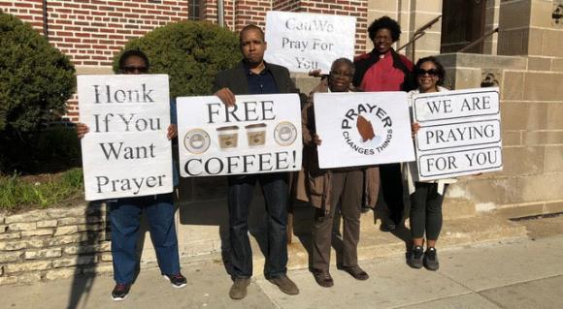
OUTDOOR WORSHIP AND PRAYER

Slide 23
TUTORING AND VOLUNTEERING AT THE SCHOOLS

Slide 24
PARISH NURSES OUT IN THE COMMUNITY

Slide 26
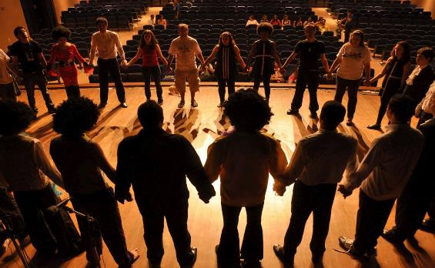
COMMUNITY THEATER

Slide 27
MUSIC LESSONS

Slide 28
HOMELESS SHELTER WORK

Slide 29
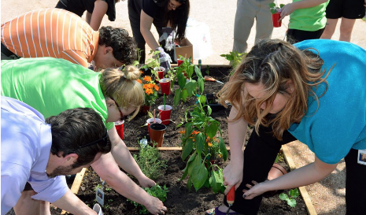
COMMUNITY GARDEN

Slide 31
ENGLISH AS A SECOND LANGUAGE CLASSES

Slide 32
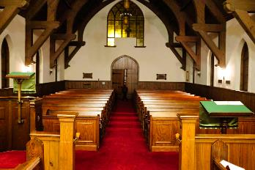
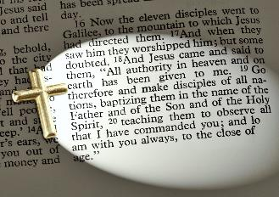
TAKE THE CHURCH OUT OF THE BUILDING AND INTO THE WORLD AS FAR AS YOU CAN GO

Slide 33
THE BOTTOM LINE IS:
Being the love of Christ
Building relationships with people outside the doors – in the community and the world
The strength and guidance for the work that comes from the Holy Spirit

Slide 34
UPDATES ABOUT GENERAL CONFERENCE 2020

Slide 35
2020 CONFERENCE THEME
PSALM 46
“… AND KNOW THAT
I AM GOD”

Slide 36
May 5 – 15, 2020
Minneapolis, MN
22.3 hours of legislative committee work and 27.8 hours of plenary voting
862 delegates – 44% from outside the USA 56% from the USA
EPA – 8 voting delegates (half lay / half clergy)

Slide 37
MANY ISSUES TO BE DISCUSSED
Social Principles Revision
Pension revision – Defined Contribution pension going forward
Financial Stability – budget adjustment
Global Book of Discipline
Number of bishops in Africa

Slide 38
2019 GENERAL CONFERENCE KEPT
TRADITIONAL LANGUAGE
WITH ENFORCEMENTS …
STRONG REACTIONS FOLLOWED

Slide 39
Various plans have been sent to GC to create a new form of unity
UMC Next
Indianapolis Plan
Bard-Jones Plan
USA becoming a regional conference
New Expressions WorldWide

Slide 40
Disaffiliation petition from GC 2019 being revisited due to the discovery of fraudulent voting
4 non-credentialed persons voted who could have changed the outcome of this decision

Slide 41
LISTENING SESSIONS
FOR GENERAL CONFERENCE UPDATES:
Wednesday, March 25, 2020 – 7 pm to 8:30 pm
Church of the Good Shepherd, 1500 Quentin Rd., Lebanon PA 17042
Thursday, April 2, 2020 – 7 pm – 8:30 pm
Downingtown UMC751 East Lancaster Ave, Downingtown, PA 19335,
this event will be streamed and accessible by ZOOM)

Slide 42
LISTENING SESSIONS
FOR GENERAL CONFERENCE UPDATES:
Saturday, April 4, 2020 – 10 am to noon
Simpson House, 2101 Belmont Ave.,
Philadelphia, PA 19131
Monday, April 20, 2020 – 7 pm to 8:30 pm
Wesley UMC, 2540 Center St.,
Bethlehem PA 18017

Slide 43
POST GENERAL CONFERENCE
“WRAP - UP” SESSIONS
WITH BISHOP JOHNSON
Saturday, May 23, 2020
10 am – 12 noon
West Lawn UMC (Reading, PA)
Saturday, May 30, 2020
10 am – 12 noon
Aldersgate UMC (Wilmington, DE)

Slide 44
EPA ANNUAL CONFERENCE 2020
June 18 – 20, 2020
Oaks Convention Center, Oaks, PA
Theme: “Community Evangelism”

Slide 45
EPA ANNUAL CONFERENCE 2020
Speakers
Latino/Hispanic Ministry
Rev. Junius Dotson (Community Leadership)
Bishop Mark Webb (Ordination service)
Bishop Peggy Johnson (Memorial service

Slide 46
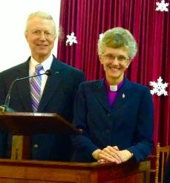
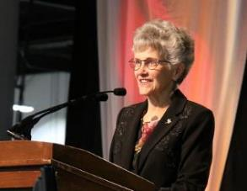
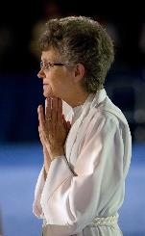
Farewell (likely) for Bishop Johnson
September 1, 2008 – August 31, 2020
EPA ANNUAL CONFERENCE 2020

Slide 47
NORTHEASTERN JURISDICTIONAL
CONFERENCE 2020

Slide 48
NEJ CONFERENCE 2020
July 13 – 17, 2020
Delta Hotel – Hunt Valley, Maryland
8 delegates from PDC and 16 from EPA (half lay and half clergy)
Total number of delegates from the 9 areas (10 conferences) are 188 (including the youth)

Slide 49
BUSINESS OF THE NEJ
Possibly elect a bishop – but maybe not if we are downsizing
Elect leadership for the Jurisdiction for the next 4 years
Approve the jurisdictional budget

Slide 50
BUSINESS OF THE NEJ
Announcement regarding the number of episcopal areas and the assignment of bishops to their new areas for the next quadrennium
Downsizing would involve more 2-point charges for bishops
NEJ Youth Event

Slide 51
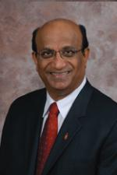
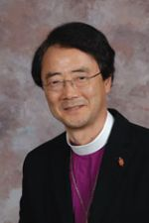
BUSINESS OF THE NEJ
Celebrate retirement
of Bishops Devadhar and Park

Slide 52
THE FUTURE IS UNCERTAIN
BUT THE LOVE OF GOD IS NEVER ENDING!

Slide 53
THE MINISTRY OF THE CHURCH
OF JESUS CHRIST GOES ON …

Slide 54
QUESTIONS
OR
COMMENTS

Slide 55
Wanted: New People to Serve on Conference Committees!!

Slide 56
Conference Committee on Leadership
Last year Rev. Anita Powell and Carlen Blackstone, led an effort to change this burdensome modus operandi by recognizing that the process needed more “buy-in” by more people—including a shift from the passive to the active, where more people ask to serve, rather than being asked.
Nominations Committee would need to evolve into one that did more than just nominate but would also help cultivate capable leadership to help the conference grow into its future.
This needs to be a continuous process, not limited to a yearly crunch period just before Annual Conference.

Slide 57
Conference Committee
on Leadership
Members and leadership determined by Committee on Leadership
Elected by Annual Conference
Conference affiliated groups, leadership determined by membership
No need for Annual Conference approval
Determine own membership and elect own leadership
Elected by Annual Conference

Slide 58
Leadership and Service Interest Form
http://bit.ly/leader-form
Paper form
Contact Maryann Griffith at: magteaches424@gmail.com

Slide 59
Process for 2020 Annual Conference Slate
All members of any committee SHOULD complete the Leadership and Interest Form at http://bit/leader-form This form will allow all Conference Ministry Chairs to search for interested people to serve on various committees.
Encourage any person who expresses an interest in any Conference Ministry to complete the form.
Committee Chairs MUST review their committee membership and notify Felicia by December 5, 2019 of any members leaving the committee in 2020 and/or recommendations for new committee members.

Slide 60
Process for 2020 Annual Conference Slate
Committee Chairs can have access to Spreadsheet generated by the Leadership and Interest Forms by contacting Maryann Griffith at magteaches424@gmail.com
All 2020 Nominations are to submitted to Felicia Anderson no later than March 30, 2020.
At District Conferences on May 17, 2020 there will be correction sheets for and additions and/or corrections to the 2020 slate.
All corrections an/or additions MUST be to Felicia Anderson by Thursday, May 21, 2020.
By doing all of this work before Annual Conference the Committee on Leadership hopes to submit a slate to the Conference body with few to no corrections needed.

Slide 61
Conference Committee on Leadership
Conference Committee on Leadership
Can only be affective with the support and interest of the people sitting around this table.
As you meet with people (both clergy and laity) please encourage them to share their gifts and talents on a Conference level.
We are always looking for new people, especially young/ younger people to serve on the various Conference Committees and Boards

