Slide 1


DISTRICT MEETING
“COMMUNITY OUTREACH”
Bishop Peggy A. Johnson
Eastern Pennsylvania Annual Conference
Fall 2019

Slide 2


DEVOTIONS
ACTS 1: 7-8, 12-14

Slide 3
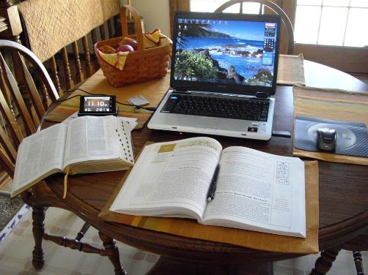
COMMUNITY OUTREACH
It needs to start with an intentional discipleship plan using the disciplines of faith driving the process

Slide 4


Slide 6
SURVEY THE NEEDS OF
YOUR COMMUNITY
Housing
needs
Faith Communities
Institutions
and
Businesses
Food
needs
Schools

Slide 7
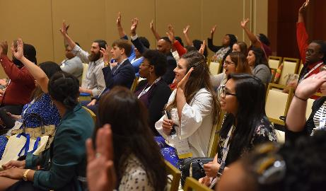
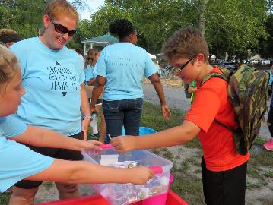
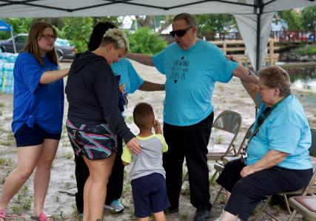
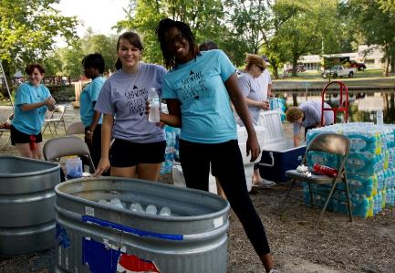
ATTEND COMMUNITY MEETINGS
AND EVENTS

Slide 8
WALK
THE STREETS
AND PRAY

Slide 9
LEARN ABOUT THE INSTITUTIONS
AND BUSINESSES

Slide 10
GET TO KNOW
COMMUNITY LEADERS
AND RESOURCES

Slide 11


CONNECT WITH FAITH COMMUNITIES

Slide 12
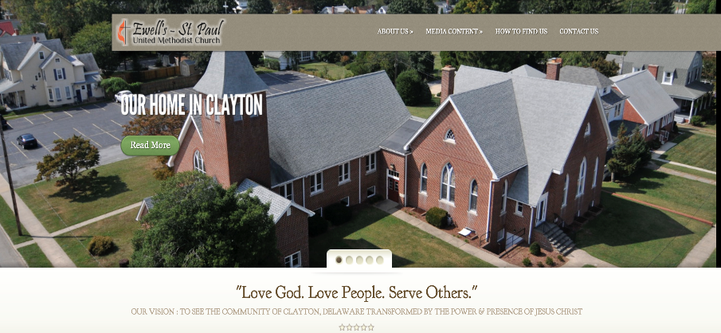
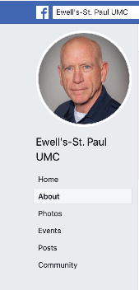
BE VISIBLE ON THE INTERNET!
Have an accessible website
and Facebook page

Slide 13

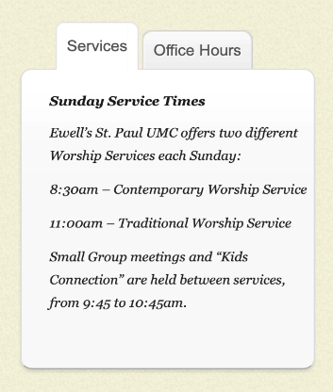
The times of services and programs should be easy to see

Slide 14

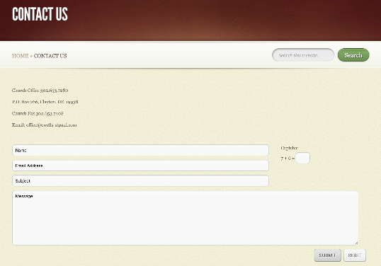
Make sure people can contact the church on this site

Slide 15

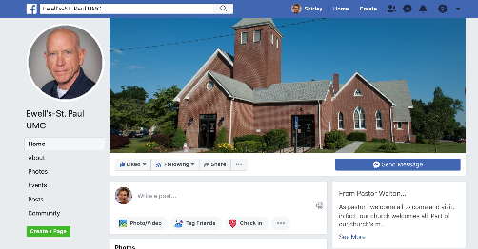
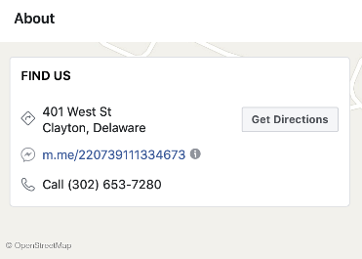
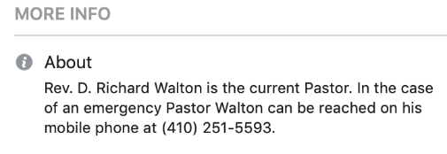
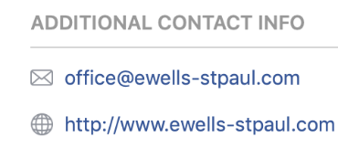
Pastors should not be hiding their names and contact information

Slide 16
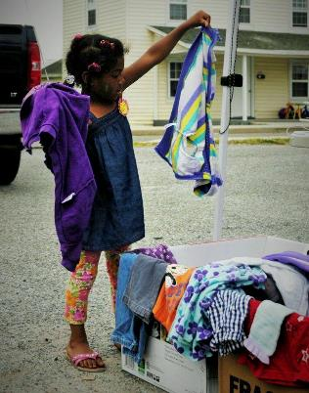
THERE IS NO END TO THE POSSIBILITIES WHEN YOU GET OUT INTO THE COMMUNITY

Slide 17
SOME
CREATIVE IDEAS

Slide 18
BLOCK PARTIES

Slide 19
FOOD
DISTRIBUTION

Slide 20

HOME
OWNER’S
CLASSES
The “KEY”
to owning
a home

Slide 21
HOME REPAIRS
IN THE COMMUNITY

Slide 22
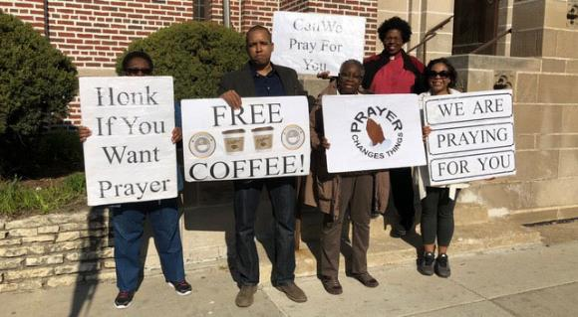
OUTDOOR WORSHIP AND
PRAYER

Slide 23
TUTORING AND
VOLUNTEERING
AT THE SCHOOLS

Slide 24

PARISH NURSES
OUT IN
THE COMMUNITY

Slide 26
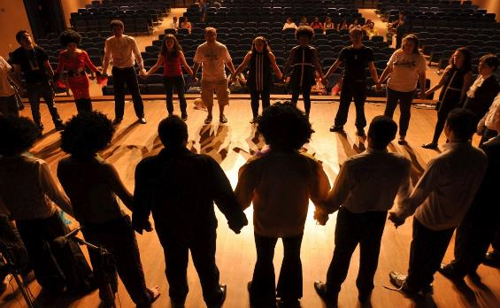
COMMUNITY
THEATER

Slide 27
MUSIC
LESSONS

Slide 28
HOMELESS SHELTER WORK

Slide 29
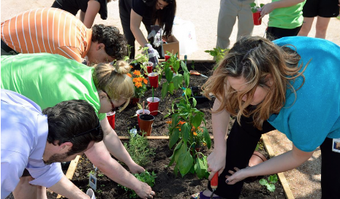
COMMUNITY
GARDEN

Slide 31

ENGLISH AS A SECOND LANGUAGE CLASSES

Slide 32
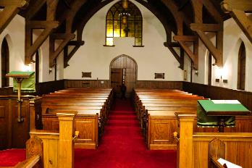
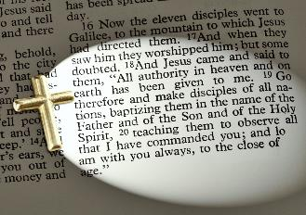
TAKE THE CHURCH OUT OF THE BUILDING
AND INTO THE WORLD AS FAR AS YOU CAN GO

Slide 33
THE BOTTOM LINE IS:
Being the love of Christ
Building relationships with people outside the doors – in the community and the world
The strength and guidance for the work that comes from the Holy Spirit

Slide 34
UPDATES ABOUT
GENERAL CONFERENCE 2020

Slide 35
2020 CONFERENCE THEME
PSALM 46
“… AND KNOW THAT
I AM GOD”

Slide 36
May 5 – 15, 2020
Minneapolis, MN
22.3 hours of legislative committee work and 27.8 hours of plenary voting
864 delegates – 44% from outside the USA 56% from the USA
EPA – 8 voting delegates (half lay / half clergy)

Slide 37
MANY ISSUES TO BE DISCUSSED
Social Principles Revision
Pension revision – Defined Contribution pension going forward
Financial Stability – budget adjustment

Slide 38
MANY ISSUES TO BE DISCUSSED
Number of bishops
Development of a global Book of Discipline
Revisiting the Homosexuality question

Slide 39
2019 GENERAL CONFERENCE KEPT
TRADITIONAL LANGUAGE
WITH ENFORCEMENTS …
STRONG REACTIONS FOLLOWED

Slide 40
STRONG REACTIONS
THAT FOLLOWED
Various plans have been sent to GC to create a new form of unity
  UMC Next
  Indianapolis Plan
  Bart-Jones Plan
  Diverse Plan
  USA becoming a regional conference

Slide 41
STRONG REACTIONS
THAT FOLLOWED
Disaffiliation petition from GC 2019 being revisited due to the discovery of fraudulent voting
  4 non-credentialed persons voted who could have changed the outcome of this decision

Slide 42
LISTENING SESSIONS
FOR GENERAL CONFERENCE UPDATES:
Wednesday, March 25, 2020 – 7 pm to 8:30 pm
Church of the Good Shepherd, 1500 Quentin Rd., Lebanon PA 17042
Thursday, April 2, 2020 – 7 pm – 8:30 pm
Downingtown UMC751 East Lancaster Ave, Downingtown, PA 19335,
this event will be streamed and accessible by ZOOM)

Slide 43
LISTENING SESSIONS
FOR GENERAL CONFERENCE UPDATES:
Saturday, April 4, 2020 – 10 am to noon
  Simpson House, 2101 Belmont Ave.,
  Philadelphia, PA 19131
Monday, April 20, 2020 – 7 pm to 8:30 pm
Wesley UMC, 2540 Center St.,
Bethlehem PA 18017

Slide 44
POST GENERAL CONFERENCE
“WRAP - UP” SESSIONS
WITH BISHOP JOHNSON
Saturday, May 23, 2020
  10 am – 12 noon
  West Lawn UMC (Reading, PA)
Saturday, May 30, 2020
  10 am – 12 noon
  Aldersgate UMC (Wilmington, DE)

Slide 45
EPA ANNUAL CONFERENCE 2020
June 18 – 20, 2020
Oaks Convention Center, Oaks, PA
Theme: “Community Evangelism”

Slide 46
EPA ANNUAL CONFERENCE 2020
Speakers
  Latino/Hispanic Ministry
  Rev. Junius Dotson (Community Leadership)
  Bishop Mark Webb (Ordination service)
  Bishop Peggy Johnson (Memorial service

Slide 47
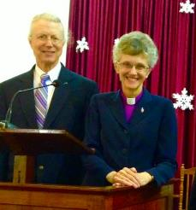
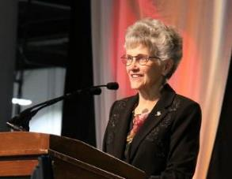
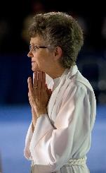
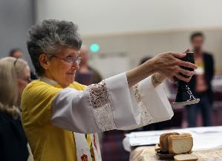
Farewell (likely) for Bishop Johnson
  September 1, 2008 – August 31, 2020
EPA ANNUAL CONFERENCE 2020

Slide 48
NORTHEASTERN JURISDICTIONAL
CONFERENCE 2020

Slide 49
NEJ CONFERENCE 2020
July 13 – 17, 2020
Delta Hotel – Hunt Valley, Maryland
8 delegates from PDC and 16 from EPA (half lay and half clergy)
Total number of delegates from the 9 areas (10 conferences) are 188 (including the youth)

Slide 50
BUSINESS OF THE NEJ
Possibly elect a bishop – but maybe not if we are downsizing
Elect leadership for the Jurisdiction for the next 4 years
Approve the jurisdictional budget

Slide 51
BUSINESS OF THE NEJ
Announcement regarding the number of episcopal areas and the assignment of bishops to their new areas for the next quadrennium
NEJ Youth Event

Slide 52
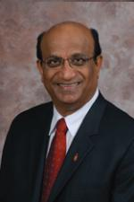
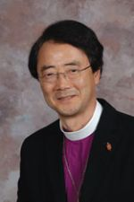
BUSINESS OF THE NEJ
Celebrate retirement
of Bishops Devadhar
  and Park

Slide 53

THE FUTURE IS UNCERTAIN
BUT THE LOVE OF GOD IS NEVER ENDING!

Slide 54

THE MINISTRY OF THE CHURCH
OF JESUS CHRIST GOES ON …

Slide 55
QUESTIONS
OR
COMMENTS

