Slide 1
Disaffiliation as of 2019
Where we are now

Slide 2
Special conference 2019
On April 25, 2019, the Judicial Council issued Decision 1379 which rules constitutional a new paragraph 2553 providing a process for local churches to exit the denomination called disaffiliation. The new paragraph takes effect immediately.
Notes:
A limited right to leave the denomination “for reasons of conscience regarding a change in the requirements and provisions of the Book of Discipline related to the practice of homosexuality or the ordination or marriage of self-avowed practicing homosexuals as resolved and adopted by the 2019 General Conference, or the actions or inactions of its Annual Conference related to these issues.
The process must be completed by December 31, 2023.
The local church must adopt a disaffiliation petition by church conference to be conducted within 120 days of the district superintendent calling for the church conference (This can happen anytime after the required mandatory 10 day notice of paragraph 246.8 up to 120 days.)
This petition must be approved by a 2/3 vote.

Slide 3
Special conference 2019
Completed by December 31, 2023.
Disaffiliation petition by church conference.
Petition approved by a 2/3 vote of church.
Approved by majority vote of the Annual Conference.
Notes:
The process must be completed by December 31, 2023.
The local church must adopt a disaffiliation petition by church conference to be conducted within 120 days of the district superintendent calling for the church conference (This can happen anytime after the required mandatory 10 day notice of paragraph 246.8 up to 120 days.)
This petition must be approved by a 2/3 vote.
Approved by majority vote of the Annual Conference.

Slide 4
What a church will need
Disaffiliation Agreement
The local church costs
Real and personal property.
Notes:
The Conference Board of Trustees shall establish the terms and conditions of disaffiliation which will be memorialized in a Disaffiliation Agreement.
GCFA has developed a Disaffiliation Agreement and the Annual Conference may develop additional standard terms that are not inconsistent with the GCFA form.
The local church shall pay any unpaid apportionments for the 12 months prior to disaffiliation as well as an additional 12 months of apportionments.
A disaffiliating local church may retain its real and personal property.
The local church must contribute an amount equal to its pro rata share of any unfunded pension obligations to the Conference.

Slide 5
What a church will need
Pension Liability
Debts, loans, and other liabilities
Payment prior to the effective date of departure.
Notes:
The local church shall satisfy all other debts, loans, and liabilities, or assign and transfer them to its new entity, prior to disaffiliation.
Payment shall occur prior to the effective date of departure.

Slide 6
How does a church move forward with disaffiliation?
Cabinet
Board of Benefits
Trustees
Notes:
A local church would work with their DS to begin the disaffiliation process.
The Board will determine the pro rata cost for pension liability and other benefit costs for the local church.
The Trustees are at the center of the disaffiliation process and must negotiate the Disaffiliation Agreement with the local church.

Slide 7
Who is part of the conference negotiation team?
The Chairperson, Trustees
The Conference Chancellor
The Conference Treasurer
The District Superintendent
The Director of Connectional Ministries
The Executive Director, Board of Benefits
Any advisory committee that may be established by the Trustees

Slide 8

What Pension liability?
A pension is a promise to provide funds at a future date .
The promise of a pension creates a liability
Notes:
A pension is a promise to provide funds at a future date (usually after retirement).
The promise of a pension creates a liability – there is an amount that will be required at some future date. If the promises of payment are more than the amount invested, there is an unfunded liability.

Slide 9

Who is responsible?
The Annual Conference
Notes:
The pension plans of the United Methodist Church make the annual conference responsible for the pension liabilities relating to the service of the clergy in the annual conference.

Slide 10
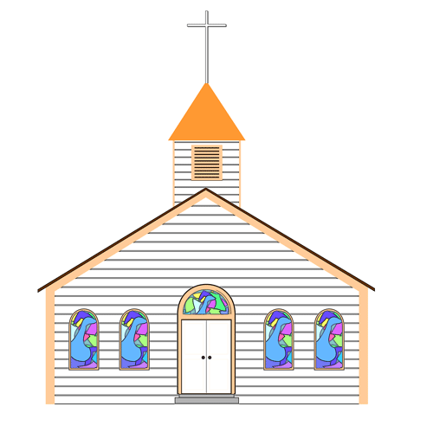
Who is responsible?
The Local Church
Notes:
There is no practical way to make each local church responsible for the pension, since pastors move from church to church over the course of their ministry.
The annual conference can more easily track a pastor’s ministry over their career.
Of course, the annual conference has no funds except what local churches in the conference provide. The annual conference charges local churches the amount needed to meet the pension needs.

Slide 11
Pension Billing
Direct bill
$6000 for a 100% appointment in 2019
Notes:
Our annual conference has chosen to direct bill the pension to the local church for the pastor(s) appointed to the church, during their time of service.
$6000 for a 100% appointment

Slide 12
WHY SHOULD A disaffiliating CHURCH PAY PENSION LIABILITY?
Pastor’s service over life of local church
Connectionlism
Notes:
Pension liability is accrued as pastors serve churches. Each local church has a share of the overall pension liability, for the service of the church’s pastors over the years.
As long as the churches of the annual conference remain together, they can be called upon to help whenever a shortfall is discovered.
In 2010, all of the churches contributed to the funds we had to pay for the shortfall in the MPP account. (About $500,000)
The departing church is asking the churches that remain to assume the departing church’s share of the overall pension liability.
In the commercial world, the rate a commercial insurer would charge to assume such a liability would be 110% of the actual liability.

Slide 13
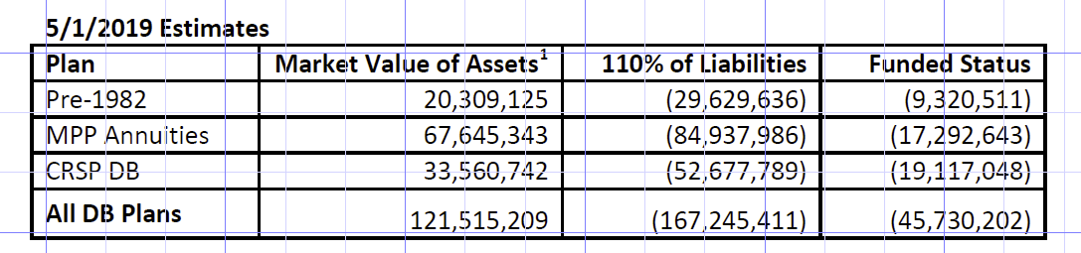
calculating the Pro Rata portion for each church
Notes:
As of May 1, 2019 our conference portion of the aggregate funding liabilities is $45,730,202
This is a snapshot in time, and is only considered a valid representation of our conference’s funded status until 7/31/2019.
This figure is not something we calculate on our own. We are required to use the figures provided by the Actuaries at Wespath.

Slide 14
Assumptions
10% Liability Premium
110% Funding
CRSP DAC Increase of 2.5%
No Increase for PSR
FTSE Discount Curve as of 4/30/2019
Notes:
This valuation does not determine liabilities on a plan termination basis, for which a separate extensive analysis would be required.
Liability measures shown include a premium to estimate the cost of transferring risk to a third party.
Actual costs related to such a transfer are dependent on market conditions at the time of transfer and may be more or less than the assumptions used.

Slide 15
calculating the Pro Rata portion for each church
3-year Average Grand Total Paid.
Includes an average of 3 years.
Includes approved Appeals
Notes:
The current formula for calculating apportionments, direct bill and composite rate tiers is based on each church’s 3-year Average Grand Total Paid.
This formula already has an average factored into it.
This formula takes into account any appeal negotiations with the cabinet and CFA for struggling churches.

Slide 16
calculating the Pro Rata portion for each church
The Board proposes using the church’s percentage of the Conference remittance figures for the year of disaffiliation as the percentage of liability.

Slide 17
More than just pension liability. . .
Other pieces may include:
  Property and Liability
  Future Retiree Health Obligation
  Historical Balances
  Loans
  Provisions for cemetery care, if applicable
Notes:
Pension obligations are just one piece of the puzzle.
Other pieces may include:
Property and Liability
Future Retiree Health Obligation
Historical Balances
Loans
Provisions for cemetery care, if applicable

Slide 18
Disaffiliation Negotiations
The Negotiation of the Board of Trustees
Advisory Committee or other vehicle
Notes:
The Negotiation Team is in the process of creating a checklist to track all points to be covered in negotiations. While pension liability must be paid, the discussion with the trustee is exactly as stated: a negotiation.
The trustees may set up an advisory committee or other vehicle to be used to consult with the conference leadership representatives and prepare its proposals required by paragraph 2553.

Slide 19
Resolutions
Resolution 2019-18L
Resolution 2019-19L
Notes:
Resolution 2019-18L, presented by the Conference Trustees clarifies the use of Resolution 2015-17 for disaffiliating churches in cases other than reasons established in ¶ 2553.
Resolution 2019-19L, presented by the Board of Benefits establishes a consistent method for determining the pro rata portion of pension obligations.

