Slide 1
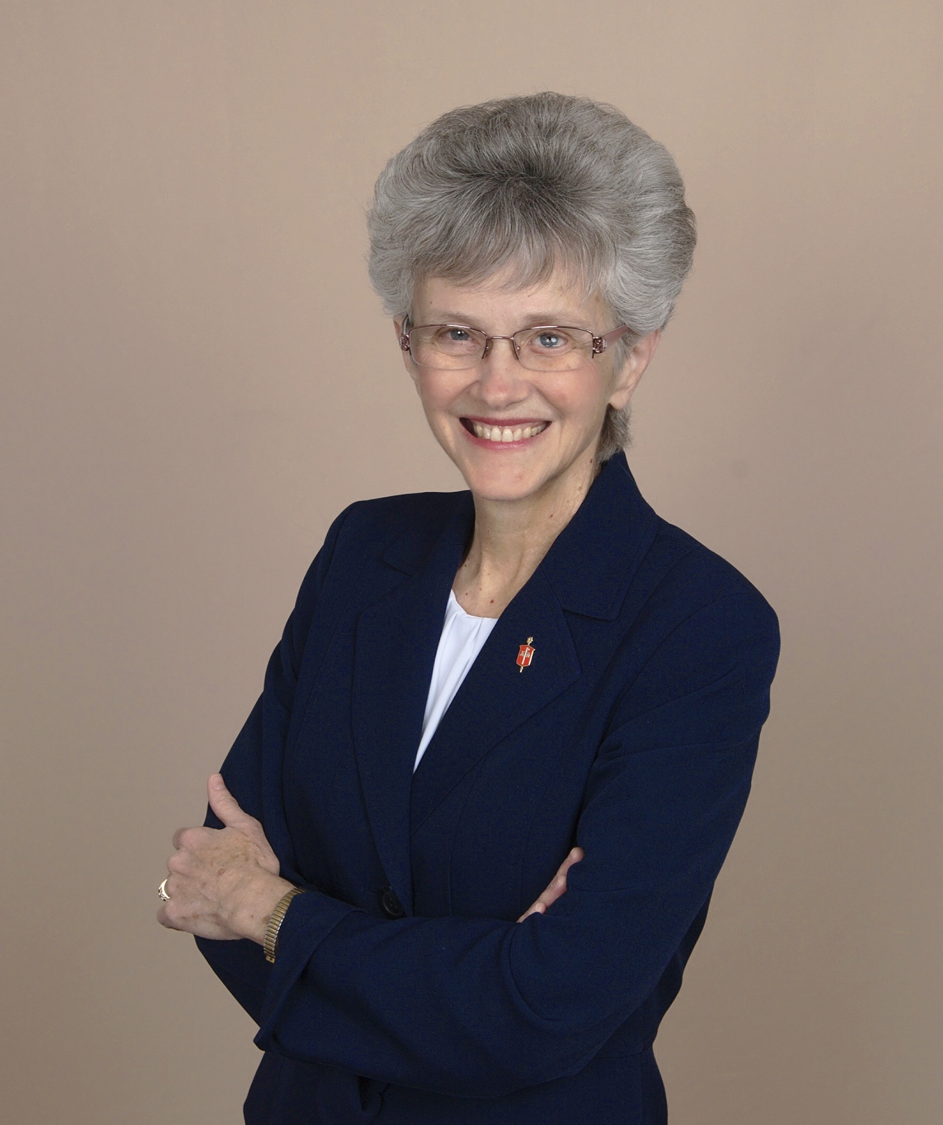
Town hall meetings on the districts “The Way Forward”
Bishop Peggy A. Johnson
Fall 2018

Slide 2
Ephesians 4:3
“Make every effort to keep the unity of the Spirit through the bond of peace.”

Slide 3
2016 General Conference established a “Commission for the Way Forward with bishops overseeing the process. The “Commission” was an inclusive group of UMC people
The “Commission” worked for 2 years and held 9 meetings. They sought unity, mission and contextual flexibility
The “Commission” presented three plans (“Traditional,” “One Church,” and “Connectional Church”)
The bishops, including Bishop Johnson, supported the “One Church Plan” by an overwhelming majority

Slide 4
The Judicial Council ruled in May that other plans in harmony with the GC mandate of the Commission could be submitted before the July 8th deadline and that the Commission brings the plan to General Conference 2019 (and not the bishops)
Over100 other plans have been sent in and are being vetted
A special called session of General Conference is set for February 23-26, 2019 in St. Louis, MO

Slide 5
October 23-26, 2018 Judicial Council meeting in Zurich, Switzerland
The Judicial Council will consider a 231 page and 48 petition document from the Commission. They are to rule if these plans pass the “constitutional test.” Each part of each plan is parsed out for individual rulings. Plans could change depending on the decisions at this meeting

Slide 6
General Conference 2019
There are 864 delegates from the entire connection, half clergy, half lay, most are the 2016 delegates, 42% from outside the US, the Philadelphia Area has been allotted 12 votes total (8 from EPA and 4 from PDC)
Bishops only preside at this meeting and do not vote
GC will determine what we will do about the paragraphs in the Book of Discipline that deal with homosexuality, the ordination of homosexual people and same gender weddings/unions

Slide 7
What united Methodists need to do in preparation for this meeting:
Pray that God’s will be done
Study Scriptures and other resources and discuss
Do the works of Christ – share the gospel and engage in mission
Be an un-anxious presence – hold fast to the “peace that passes understanding”

Slide 8
Pray
Website: UMCprays.org – provides many helps, lists of delegates, GC organizers, bishops, scriptures,
Pray every day from 2:23 to 2:26 pm
Wesley Fast – sundown on Thursday through Friday at 3 pm.
Plan for prayer vigils at your churches before and during General Conference

Slide 9
Study and discuss
Study the Word of God, particularly those passages that deal with unity and cultural and theological diversity
Study the many books and articles on the topic and have a book study at church or during Sunday School (these are posted on the Conference website)
Become familiar with the three plans and other plans that may be submitted

Slide 10
Follow the developments on https://www.umnews.org (sign up for the daily digest)
Invite elected delegates and/or persons of various perspectives to come and speak at your church

Slide 11
Three plans (latest updates)
Traditional
One Church
Connectional Church

Slide 12
The Traditional Plan

Slide 13
Affirms the current language in the Book of Discipline which bans “self-avowed and practicing” homosexual clergy and the blessing of same-gender unions/marriages with strict enforcement of these bans. Also homosexuality is considered contrary to Christian teaching. Marriage is only between a man and a woman
Churches and annual conferences that disagree with these enforcements are encouraged to set up self-governing or “autonomous, affiliated or concordant” churches or conferences

Slide 14
Broadening the definition of “self-avowed practicing homosexual” to include anyone living in a same-sex marriage, domestic partnership or civil union, or who publically states that he or she is a homosexual.
Setting minimum penalties (one year suspension without pay at the first violation) and quicker expulsions after conviction of violations

Slide 15
Bishops and annual conferences must certify that they would uphold, enforce and maintain the Discipline’s standards on marriage and ordination.
Bishops who could not do so would not be eligible for compensation for their expenses after 2021 and would be urged to join the self-governing churches.
Bishops would not be allowed to consecrate, ordain, or commission a person who is a homosexual even if they were elected or approved by the relevant committees such as the BOOM or the executive clergy session

Slide 16
Churches that disagree with a conference that refuses to enforce the Discipline can remain in the UMC by aligning with a conference that enforces the BOD
Churches that disagree with a conference that wishes to enforce the Discipline could band together to join an “autonomous, affiliated or concordant” church. Groups of 50 or more could form a new denomination

Slide 17
Encourage clergy who could not maintain the ban against homosexual marriage and ordination to leave the denomination and join the self-governing churches
Require any “just resolution” of a complaint to contain a commitment not to repeat the offense
Require every annual conference to certify that they will maintain the bans and if not, they would be encouraged to form a self-governing body

Slide 18
The current general agencies could negotiate their services with churches and conferences that leave the denomination
Boards of Ordained Ministry must specifically ascertain whether or not a candidate is a practicing homosexual, including looking at information on social media
There is a time line for churches or conferences to form a self-governing church with detailed procedures on how funds and pensions will be handled. All must be in place by January 1, 2021

Slide 19
The One Church Plan

Slide 20
The plan “gives churches the room they need to maximize the presence of the UM witness in as many places in the world as possible.”
It eliminates the paragraphs in the Discipline that talks about homosexuality being incompatible with Christian teaching. It deletes the ban on ordaining homosexuals but allows each conference and clergy session to determine their standards. Clergy will never be forced to perform a same-gender marriage and no one is forced to act out of their conscience.

Slide 21
In the US the local church members can decide what is best for their congregational and missional context relating to same-sex marriage on their church property. Local churches must vote at a church conference (open to all members) to allow their property to be used for a same gender ceremony.
Central Conferences can retain the present Discipline language banning ordination and marriage of homosexual people. They can vote what best serves their missional context
Each jurisdiction would pay for their own bishops

Slide 22
If a clergy person decides to leave the denomination their vested pension will be protected at the time of their departure. They can also seek to transfer to another annual conference
Exiting churches must follow the current UM Disciplinary language about the trust clause and cannot take the building and assets and leave. There also must be provisions for pension liability that an exiting church creates
This plan does not require any amendments to the Constitution
The plan would take effect on January 1, 2020 and full implementation will be completed on December 31, 2020

Slide 23
The Connectional Church Plan

Slide 24
This plan simplifies the General Church structure and provides space and connection between parts of the church that are in deep conflict
It replaces the existing 5 jurisdictions with 3 connectional conferences that are “values-based” rather than geographic in nature
Those values are: traditional, unity, and progressive
The central conferences (those outside the US) can join one of the three or form their own connectional conference

Slide 25
Description of the 3 Connections:
Traditional: marriage only between a man and a woman, a ban on homosexual ordination and same gender weddings with enhanced accountabilities
Unity: acknowledges that we are not of one mind, takes out the restrictive language about homosexuality, ordination of homosexual people and same gender marriages, allows churches, conferences and pastors to follow their conscience
Progressive: Same gender weddings are required of all clergy, all annual conferences must ordain qualified LGBT persons and all local churches are welcoming of LGBT pastors

Slide 26
Each Connectional Conference would create its own Book of Discipline that includes the items that are commonly agreed on with authority to adapt other items that are more specific to their theological perspective
Each Connectional Conference’s College of Bishops would provide episcopal oversight and accountability and handle elections, assignments and funding.
Each Connectional Conference would have its own administration, financing and policies regarding LGBTQ weddings and ordination.

Slide 27
Justice ministries relating to racism and sexism would be organized at the Connectional Conference level.
Cross Connectional Conference cooperation and partnerships would remain and all would continue to support mission work and ministry outside the US.
General Conference would be shorter and would retain authority over the church’s shared doctrine and services of continuing the general agencies. Mostly it would be a time of worship, inspiration and sharing best practices

Slide 28
The General Agencies that would continue are: Pensions (Wespath), the Publishing House, Finance and Administration, Archives and History, and some parts of the Board of Global Ministries (including the Committee on Relief)
The future structure of other agencies would be determined by the connectional conferences
The Judicial Council would have 2 elected persons from each connectional conference

Slide 29
Each jurisdiction would determine the connection they wish to join. Conferences and churches that disagree can join another one in another part of the country.
Jurisdictional property would belong to the affiliated connectional conference.
Retirement of bishops in 2020 would be waived (as needed) during this transitional time until 2022. General Conference 2024 would be postponed until 2025

Slide 30
What do we do in the meantime?
We discussed prayer and study/conversation
What else?

Slide 31
Do the works of Christ!!
Acknowledge that there is far more that we agree on than disagree on
Our mission is to Make Disciples for Jesus Christ for the transformation of the World.
This is important work we are doing with General Conference but it should not stop us from our ministries
Be in fellowship and ministry with those with whom you disagree

Slide 32
More than half of our churches have not taken in a single member in 2017
Number of new baptisms in 2017: 798 in PDC and 850 in EPA
Number of new professions of faith in 2017: 1,260 in PDC and 1,506 in EPA
There are more than 400 churches in each conference! We could be reaching out more and evangelizing for the Kingdom of God

Slide 33
Finally – Be an un-anxious presence
Trust that God will lead us and empower us for the days ahead
Speak positively about the good that God is doing

Slide 34
I Peter 5:7
“Cast all your anxiety on God because God cares for you.”

Slide 35
Questions? Comments?

