Slide 1
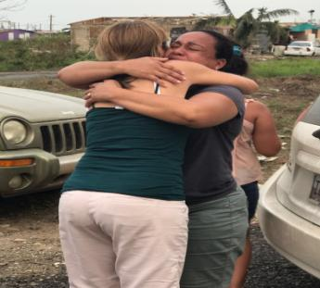
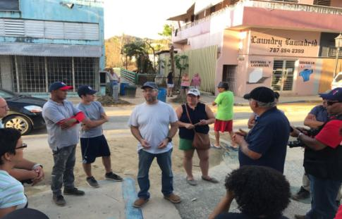
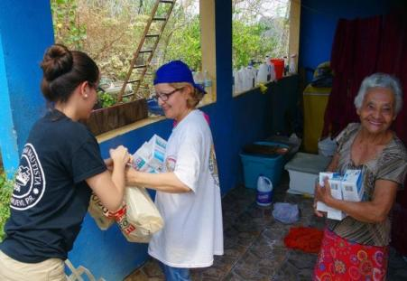
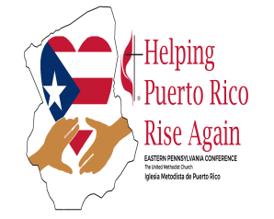
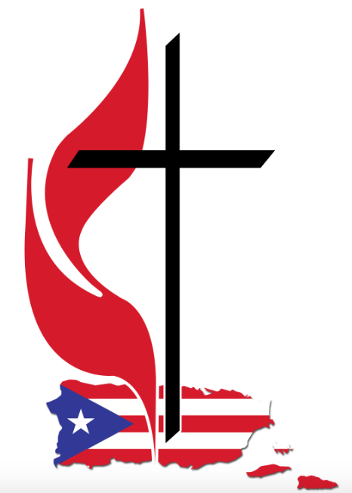
EASTERN PA TASK FORCE FOR PUERTO RICO RECOVERY
“A comprehensive plan for a
sustainable recovery in puerto Rico”
Rev. BK Chung,
Rev. Nicolas Camacho
Rev. Tracy Bass,
Rev. Irving Cotto
Rev. Herbert Coe.
Andres Cotto

Slide 2
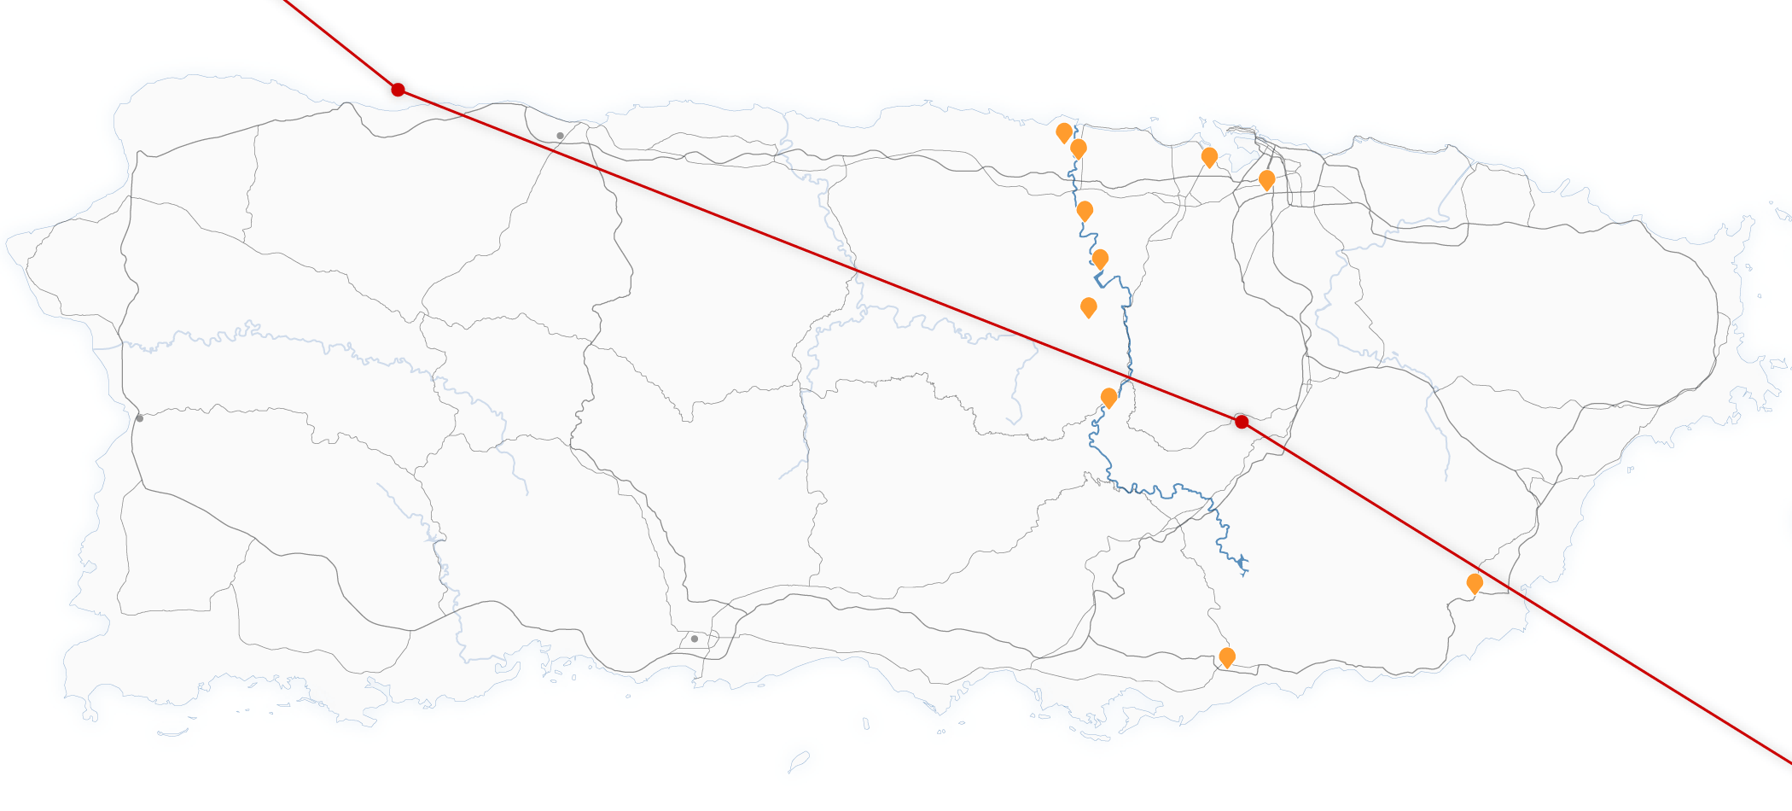
The Storm’s Impact in Puerto Rico
Hurricane Maria
Sept. 20, 2 p.m.
Arecibo
Dorado
Cataño
San Juan
Toa Baja
Roberto Clemente
Coliseum
Toa Alta
La Plata Dam
Naranjito
Mayaguez
Comerio
8 AM
Yabucoa
Ponce
Guayama
6 hours

Slide 3
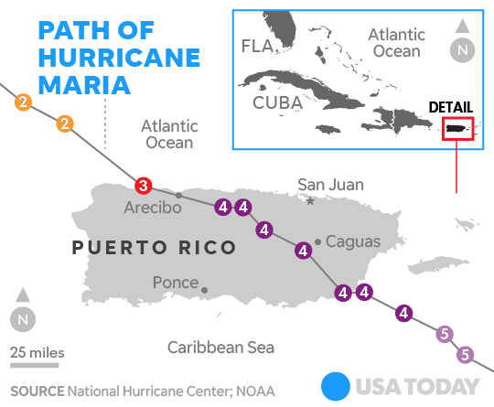

Slide 4
Number of Methodist Churches / Congregations
96 in the main island
02 in Vieques
01 in Culebra
01 in St. Croix
Total of 100 churches
Damages to Sanctuaries
30% of the Methodist churches in the island were damaged
10% are not safe & can’t not be used
There is not a clear path and time in their rebuilding.

Slide 5
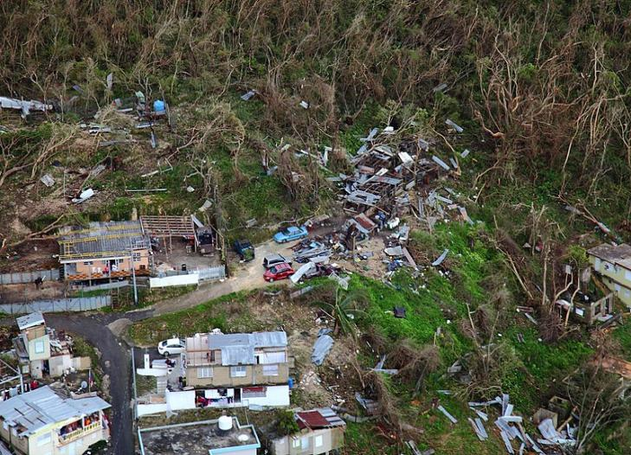
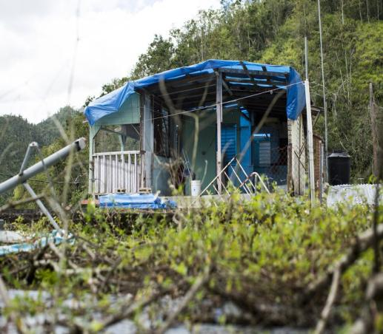
Thousands of homes in Puerto Rico have yet to be fixed. Here’s a picture, taken on March 1 of a home in Comerío, a town in the mountains that is still mostly without power. Erika Rodríguez/The Washington Post via Getty Images
Thousands of homes suffered varying degrees of damage while large swaths of vegetation were shredded by the hurricane's violent winds

Slide 6
Who's been most affected by the destruction?
Government & NGO Stats
The scale of Maria’s has caused as much as $94 billion in damage
As of February, an estimated 60,000 houses were still roofless, and approximately between 600-700 people are still displaced, living in shelters or with friends or relatives.
According to the Department of Education, six percent of Puerto Rico’s students have left the island since Maria hit.
I
***The lack of electricity, running water and reliable communications remain central challenges to the Caribbean island as it struggles to return to a semblance of normal life.
II
Who's been most affected by the destruction?
The storm disproportionately affected Puerto Rico’s poorest residents, who have fewer resources on hand to help them recover and rebuild. ***Many of these people live in more rural communities and the hard-to-reach areas of the mountains, and can expect to be the last to regain access to water or see their electricity restored. The storm left thousands of families without homes and destroyed some communities entirely.
III
Children and young people are particularly vulnerable to the psychological impacts of disaster, and many depend on the resources and support they find at school to help them overcome trauma-induced stress.
***Hurricanes Irma and Maria disrupted the lives of some 350,000 public school students.
Notes:
According to Saffir Simpson a category 5 Will cause the destruction of a high percentage of framed homes and infrastructure.
Official reported deaths: 50, but different sources in the Island argue that the number is higher : 500- 1,000 (There are other deaths related to the loss of power and hospital services.)
*** FEMA

Slide 7
6 months after Hurricane Maria, Puerto Rico has a suicide crisis and a housing shortage
Few Puerto Ricans can return home while many have fled the Island
More than 3,500 Puerto Ricans are still living in hotels on the island and across the United States with temporary housing vouchers provided by FEMA. The program has been extended twice by the agency because few homes have been fixed.
FEMA has approved less than 40 percent of the 1 million applications for money to help disaster victims fix their homes, according to NPR. The reason is that many, many Puerto Ricans do not hold the deeds to their homes
According with to the Florida Division of Emergency Management, more than 269,000 people have arrived in Florida on flights from PR since the hurricane.
Demographers expect Maria to trigger an even larger migration in the long term. The Center for Puerto Rican Studies at the City University of New York estimates that Puerto Rico will lose up to 470,335 residents by the end of 2019 — about 14 percent of the population.
The migration has already affected Florida. More than 10,000 Puerto Rican children have enrolled in Florida’s public schools in the past three months.
The island is dealing with a suicide crisis
The number of people on the island who have reportedly tried to kill themselves since Hurricane Maria hit the island has more than tripled.
From November 2017 through January 2018, a crisis hotline run by Puerto Rico’s Department of Health received 3,050 calls from people who said they had attempted suicide. That’s an astounding 246 percent increase compared to the same time last year.
This data was released by the health department’s Commission for Suicide Prevention
These numbers offer a snapshot of the mental health crisis unfolding in Puerto Rico and the urgent need for our VIM Teams to be trained on how to deal with issues of trauma, etc.

Slide 8
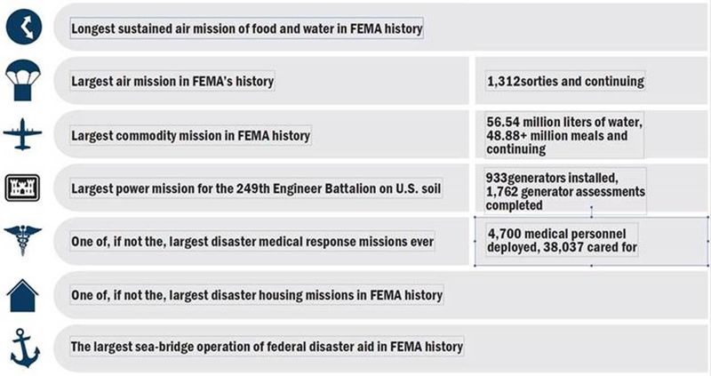
Here’s a chart FEMA made to remind people of the gargantuan efforts the agency has made in Puerto Rico since the hurricane hit:

Slide 9
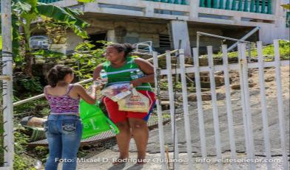
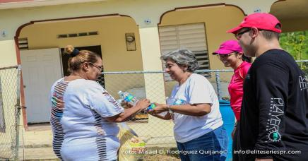
What has been done by the PRMC?
Emergency Phase

Slide 10
Distributed grocery bags and water
Created & identified distribution centers around the Island: 10 Churches
Grocery Bags:
Worth in food for 2 people for 3 days
Total bags distributed: 12,000 families
Total spent: $144,000
Visited & assessed isolated towns
Traveled to open roads, cleaned debris, and provided grocery bags and water in the center of the Island (Mountain Region)
Jayuya, Barranquitas, Utuado, Comerio
Prepared and distributed Hot Meals
Established Locations: 5
Served approx. 10,000 people at a cost of $10,000 plus donations from other community organizations
Medical assistance
Organized seven Health Clinics for the community which were offered in local churches, providing physical examination and medicine
Organized & provided medical services from house to house with the support of nurses and physicians

Slide 11
Nurtured and strengthened the spiritual and emotional being of Puerto Ricans by:
Distributed significant copies of the Upper Room
We have to “see the other”
In times like this the church has to rise and provide hope.
3,000 Upper Room Devotionals in Spanish to be included in the grocery bags.
FEMA
Worked in coordination with and supported FEMA:
Appointed & assigned one pastor to work with FEMA as representative of the MC
Offered their facilities for training and to become points of distribution.
VOAD – Became members and is actively participating in weekly meetings.
V = Voluntary
O = Organization
A = Actively
D = Disaster

Slide 12
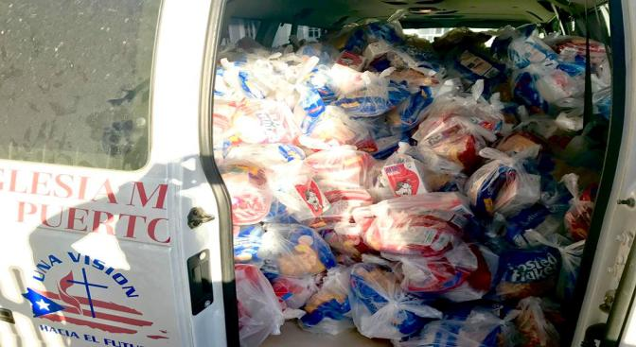
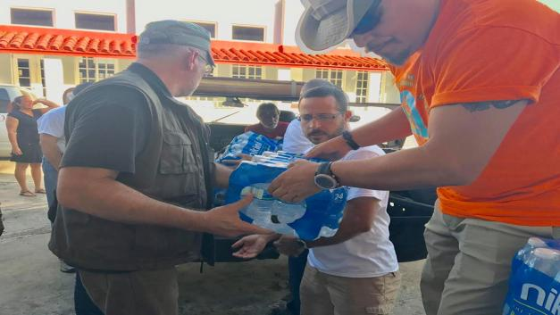
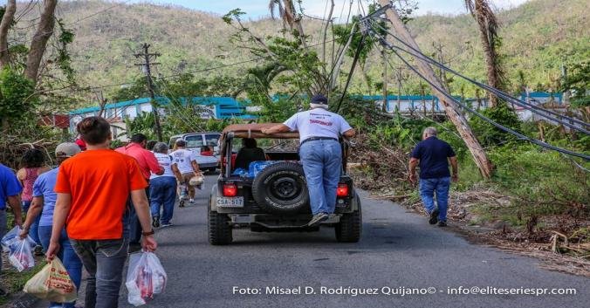

Slide 13
[A Comprehensive Plan for a Sustainable Recovery in Puerto Rico]
Recovery of Communities
Recovery of
Local Churches
New Partnerships
Work scope:
1st Proposal to UMCOR:
November 1st to October 31st
UMC Conferences
Local Churches
Specialized Mission Teams
$3.6m for a one year period

Slide 14
CONFERENCE TO CONFERENCE
CHURCH TO CHURCH
UMCOR & CHURCH
COMMUNITY RECOVERY
Coordination directly through the Conference Offices of the MCPR
Scope of Work: Church repairs
PRMC is working in a comprehensive plan for the recovery of Local Churches in three main areas
New scope of ministry
A Church that is relevant and is present
Spiritual nurture
Feeding, care, and support
Leadership development
Resiliency
Capabilities
Empowerment
Coordination through UMCOR and then MCPR’s Volunteers Coordinator.
Scope of Work: House Repairs through Comprehensive Case Management.
First Months Early Response Teams
Following by UMVIM groups skilled in construction
18 plus years old
As soon as the different areas are ready to move to the next phase, we will begin the case management phase and receiving different missionary groups to work on the reconstruction of local communities.
Full recovery will take years.

Slide 15
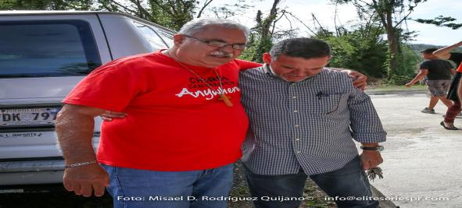
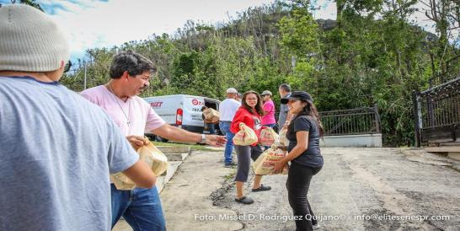
Recovery of
Communities
Recovery of
Religious Leaders & Local Churches

Slide 16
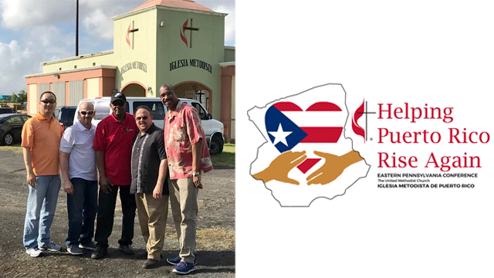
Eastern PA Delegation 14-23 FEB 2018
(From left) The Revs. BK Chung, Nicolas Camacho, Tracy Bass,
Irving Cotto and Herbert Coe.
Andres Cotto photo

Slide 17
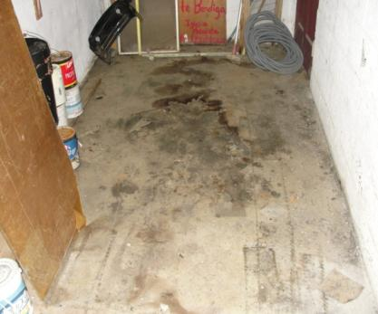
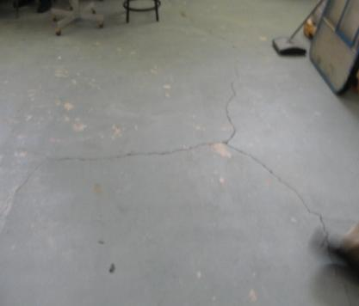
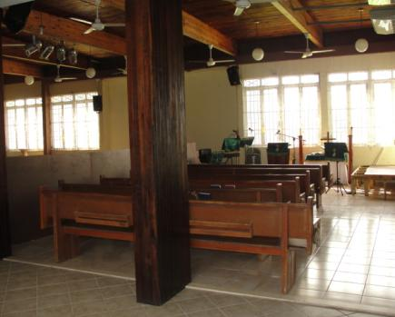
North East Region Torrimar MC, Levittown
Pastor: Brigido Ortiz
Damages:
Outside roof needs to be sealed
Classroom’s floors are cracking
Water went underneath the building causing the soil to erode
Mold on the floor and walls
An elder family affiliated to the church, lost everything inside the house.
House is ready to be occupied.

Slide 18
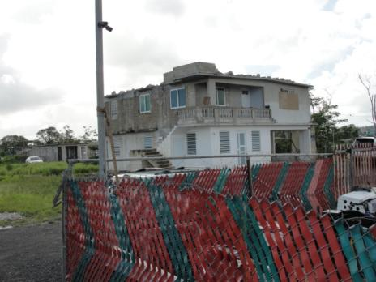
“Villas Del Sol” Community Torrimar, Levittown
A building in the community of Villas Del Sol was ravaged by Hurricane Maria. Jose Espada Marrero Methodist Church, Rio Piedras Heights Methodist Church and Torrimar Methodist Church are taking supplies to that community where there is a small chapel pastored by Bishop Emeritus Juan Antonio Vera Mendez. Photo courtesy of the Facebook page of Bishop Hector F. Ortiz.

Slide 19
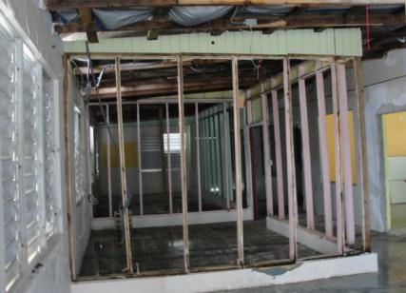
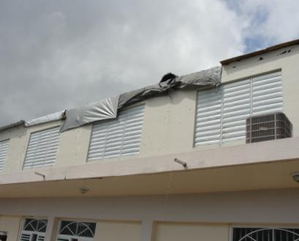
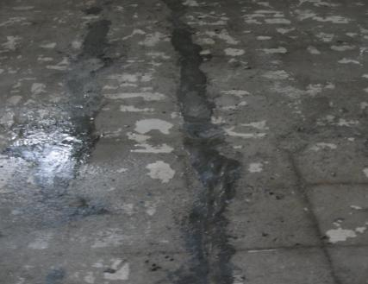
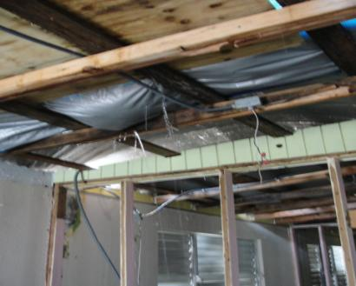
“Jesus Principe De Paz” MC - Bo. Factor, Arecibo

Slide 20
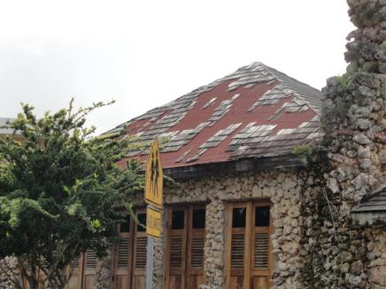
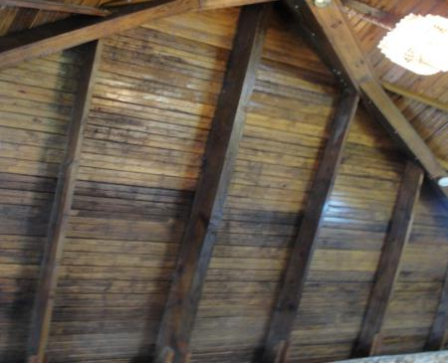
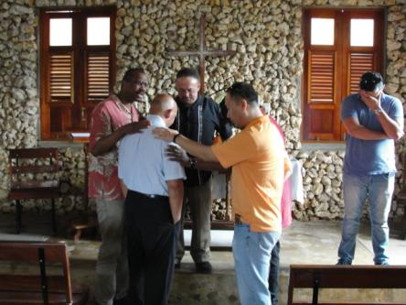
“Ernesto Memorial - La Piedra” MC Habra Honda, Hatillo

Slide 21
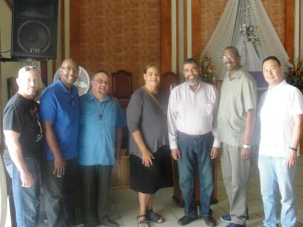
Southeast Region “El Santuario” MC Patillas
Pastor: Diana Rivera Santiago
Damages:
Outside roof
Four units – Air conditioner
Mold around the walls and classrooms
Edificio Educacional “Rosa M Ortiz Parades”
Used by UMCOR as a distribution center

Slide 22
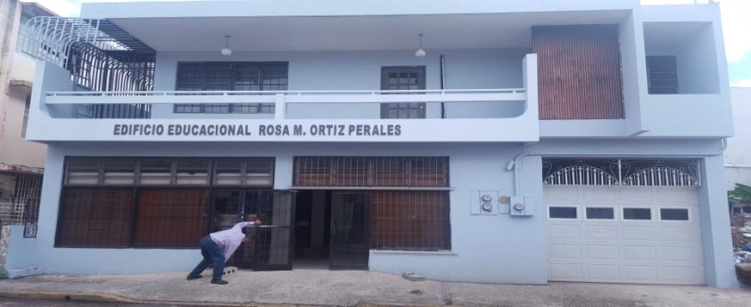
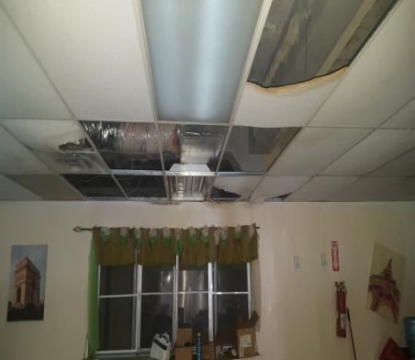
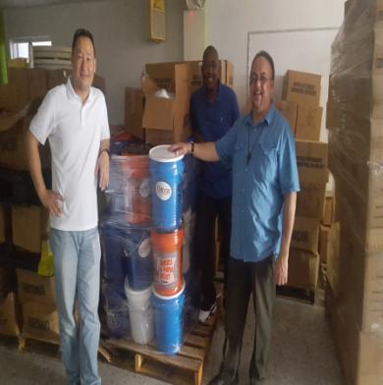

Slide 23
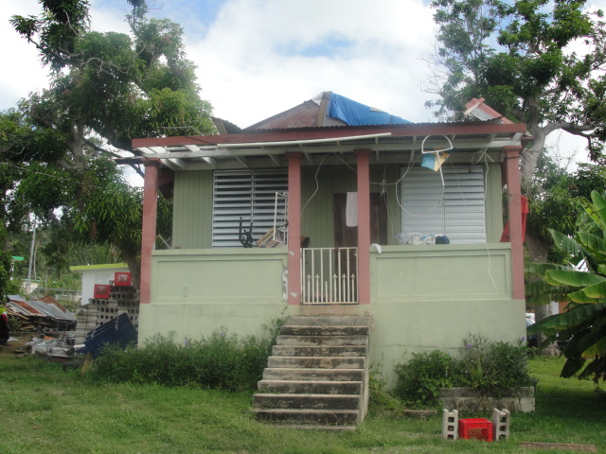
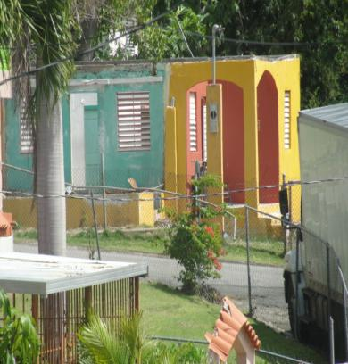
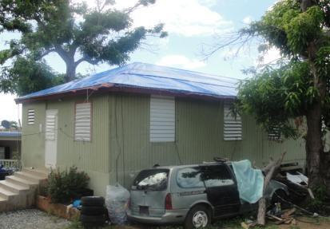
Homes of Trustees and Worship Leaders Maunabo
Home of Community Member
Maunabo

Slide 24
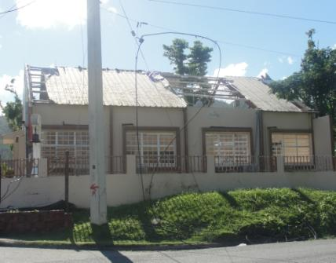
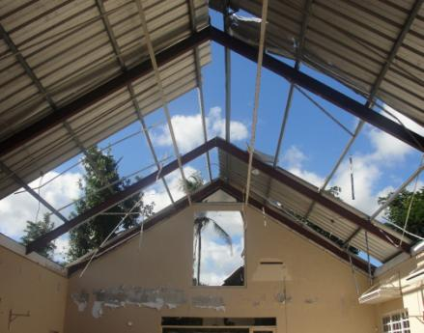
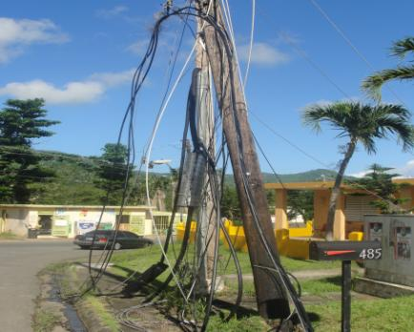
“Peña de Horeb” MC Bo. Palo Seco, Maunabo
Pastor
Damage
Roof
Electricity
Windows
Main doors to the sanctuary

Slide 25
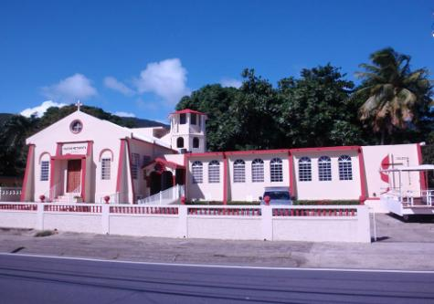
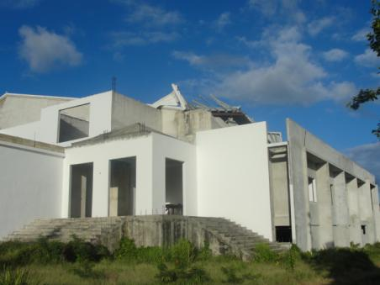
“Puerta Del Cielo” MC Bo. Guardarraya, Patillas
Pastor & District Superintendent: Isabelino Rivera
Damage

Slide 26
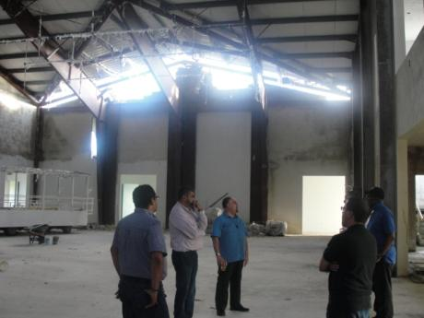
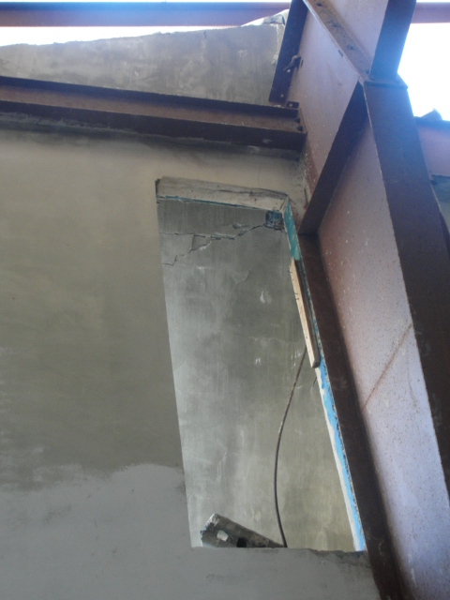
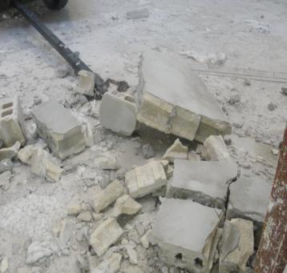
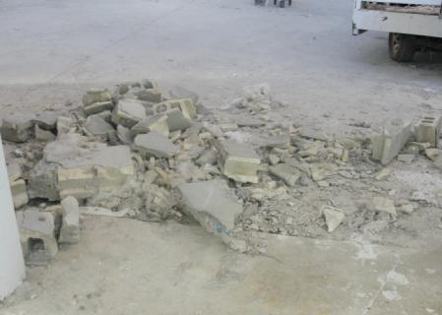

Slide 27
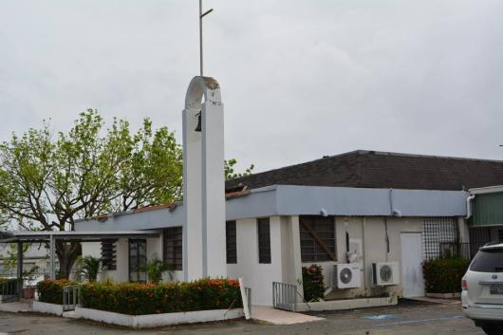
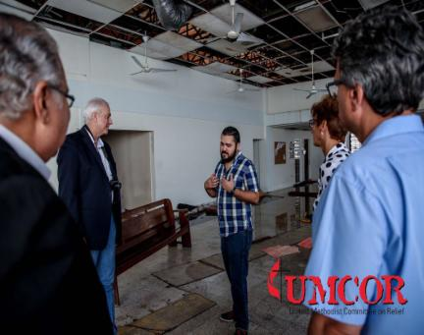
Area Metro Villa Fontana MC, Carolina
Pastor: Samuel Febo
Damage:
Roof
Walls
Floor
Electricity
90% of building received extensive damage

Slide 28
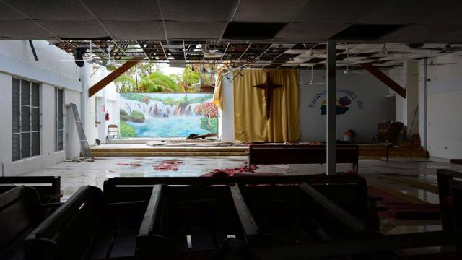
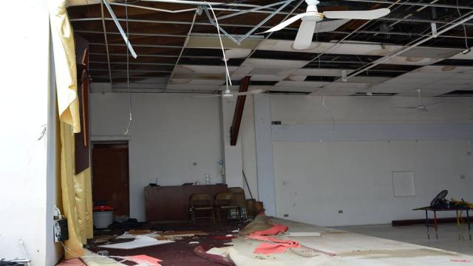
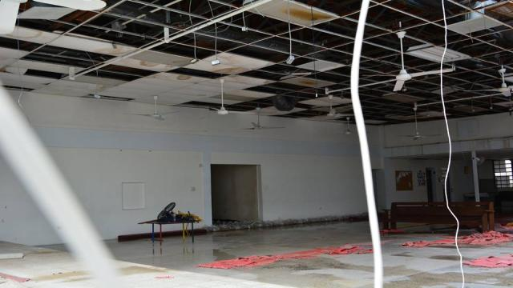

Slide 29
Mountain Region
About 40 miles from San Juan, construction is just beginning to replace a bridge that was washed out in Morovis, a municipality in north-central Puerto Rico. For now, vehicles drive across a platform on the riverbed. The far end of the lost bridge is seen at upper right. This image was shot Jan. 20, 2018

Slide 30
Esperanza
MC,
Vieques

Slide 31
Eastern PA Delegation RECOMMENDATION / CONSIDERATION

Slide 32
For consideration
Electricity probably won’t be entirely restored before May
The single biggest problem facing Puerto Rico is still the lack of power
The blackout is now the largest in US history.
Building and shipping thousands of utility poles and power lines to the island, then setting them up on mountainous terrain has become a headache for utility crews.
FEMA is overwhelmed
FEMA responders are stretched thin, to say the least. Aside from Puerto Rico, the agency is responding to multiple federal disaster zones in California, Texas, and Florida.
FEMA administrator Brock Long,
“It is time to question what is FEMA’s role in disaster management and emergency recovery,” Long told members of the House Appropriations Committee. “Let’s hit the reset button. FEMA was never designed to be first or only respondent in a disaster, but we often find ourselves in that situation.”
The reconstruction of Puerto Rico is arguably the agency's most challenging mission ever.
Helping Puerto Rico recover is a gargantuan task — FEMA has called it the "largest federal response to a disaster" in American history.
As FEMA has moved from emergency response to recovery mode, it's now focused on providing federal grants to rebuild public buildings, help homeowners repair homes, and provide loans to small businesses.
FEMA experts predict that in 2018 we could see another active hurricane season in the Caribbean, starting as early as June 1.

Slide 33
Opportunities to strengthen PRMC journey as partners in mission (1 from 3)
Covenant agreements with Annual Conferences in the UMC
Local Churches in the UMC and in Puerto Rico working together as partners in mission.
Strengthen the Voluntary in Mission Annual Conference Program.
Coordination
Following the initial phase (assessment & analysis of damages) the recovery response will be opened to traditional ERTs.
Beginning 1st April, to identify/schedule volunteer (UMVIM) reconstruction teams.
Start ASAP approaching local churches with VIM teams
Make a presentation to local churches with VIM teams
Scheduling of VIM teams through and with PRMC POCs.
Individual or through the EPA Task Force for PR Recovery?
Received training on how to deal with traumatized individuals, families
UMCOR has established a centralized volunteer coordination mechanism in cooperation with UMVIM for this purpose.
EPA Task Force for PR Recovery
Prepare-train-certify ERTs
When & Where
Two trainings per year (probably three)
Received training on how to deal with traumatized individuals, families

Slide 34
Opportunities to strengthen PRMC journey as partners in mission (2 from 3)
Establish new partnerships with NGOs and other religious & non-religious organizations.
Approach new teams, groups.
Red Cross – Joseph Pruitt
Train our VIM Teams
Create and identify a bank of available resources
Medical Mission Teams
Local hospitals
Church members
United Methodist Hospitality Network
Puerto Ricans moving to the US Mainland looking for a better life in states such as:
Florida / Texas / New York / New Jersey / Pennsylvania / North Carolina / Georgia / Chicago / Illinois

Slide 35
Opportunities to strengthen & support PRMC journey as partners in mission (3 from 3)
Financial Support
Helping PR Rise Again – Conference financial support launched in JAN 2018
GOAL $100,000
Time frame:
By Annual Conference
Months before AC: Two months - April & May
Conference Districts
How can they help to market/promote/announce/encourage/etc., etc.
Latino Commission
Contribution $10,000 (Number of Establish Churches – 6 / Number of Mission Churches - 5)
Can they raise the above amount by Annual Conference?
For how long do we want to have this initiative?
[__] 1 Year [__] 2 Years [__] 3 Years [__] More than 3 years
Other Opportunities for support
Latino Heritage Month - Saturday September 15 to Monday October 15
RESOLUTION 2018 - 25
Resolution relating to a Love Offering for Puerto Rico
Presented by Eastern Pennsylvania Task Force for Puerto Rico Recovery

