Slide 1
Men’s Ministries
Value and Challenges
By David J. Marks
Notes:
Value and Challenge

Slide 2
Value
Fellowship
Support
Networking
Make better Christians
Boy Scouts
Force for good

Slide 3
Fellowship
Lasting friendships
Shared interests
Shared activities

Slide 4
Support
Shoulder to cry on
Moral support
Visitation
Financial
Transportation
Home repairs

Slide 5
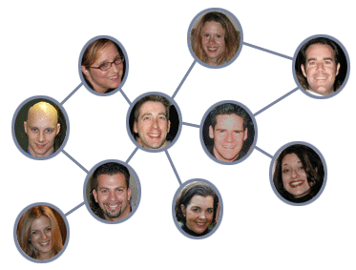
Networking
Job opportunities
Legal assistance
Tax assistance
Business assistance
Resources beyond the local church

Slide 6
Better Christians
Education
Prayer Support
Moral and ethical guidance
Outreach
Mission trips

Slide 7
Challenges
Getting men interested and excited
Creating a structured group
Time and priority
Money
Transportation
Finding common interests and values
Fighting the notion that men and women shouldn’t have separate groups
Chartering

Slide 8
Challenges Chartering
Required for local churches by Book of Discipline
Fee goes to GCUMM – portion goes to annual conference
What does GCUMM do (www.gcumm.org)?
Supports scouting – Boys, Girls, Camp Fire (www.gcumm.org/scouting)
Supports Big brothers and Big Sisters (www.gcumm.org/scouting)
Supports the Society of St. Andrew (endhunger.org/umm)
Provides leadership training for men by developing Men’s Ministry Specialists (www.gcumm.org/ministry-to-men/mens-ministry-specialists)
Provides men’s ministries resources (www.gcumm.org/resources)

