Slide 1
STATISTICAL REPORT
Calendar Year 2016

Slide 2
WORSHIP ATTENDANCE
Continued decline all districts
8% of churches report > 10% growth
19% of churches grew attendance

Slide 3
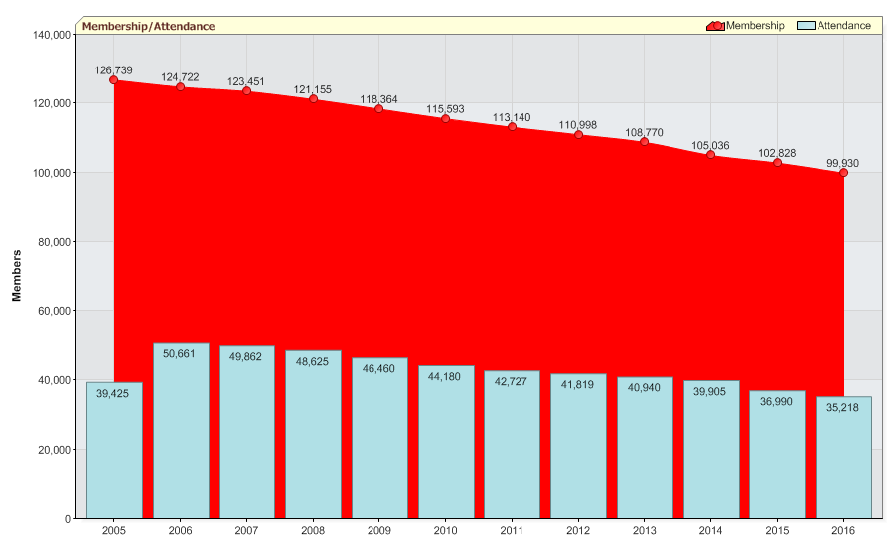
Eastern Pennsylvania Annual Conference

Slide 4
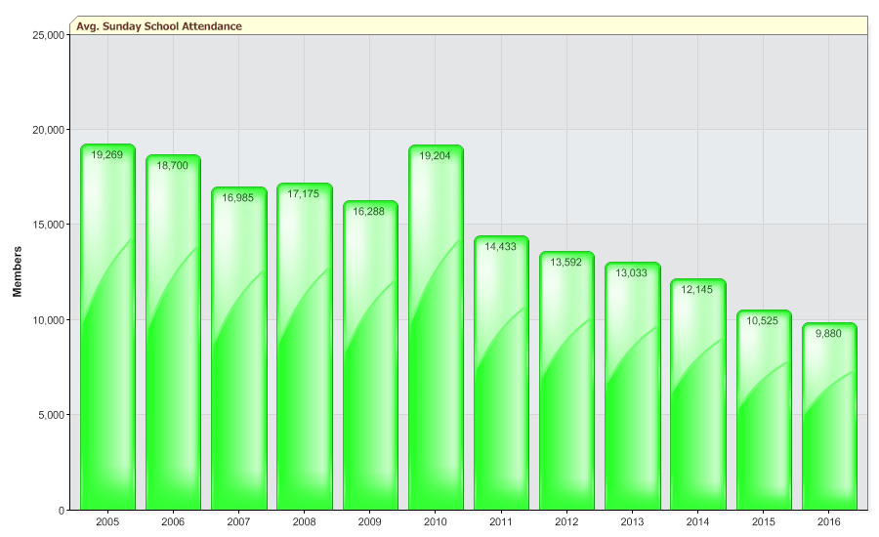
 | Eastern Pennsylvania Annual Conference

Slide 5
CHRISTIAN FORMATION
Children, Youth and Adults included
Participation rate similar to attendance
Prior years growth has begun to level

Slide 6
MISSIONS
‘VIM’ and other Teams plus those reached
Positive growth in this area
Close to half million lives touched

Slide 7
RECEIVED BY PROFESSION OF FAITH
This area is trending down and vital for reversing attendance declines

Slide 8
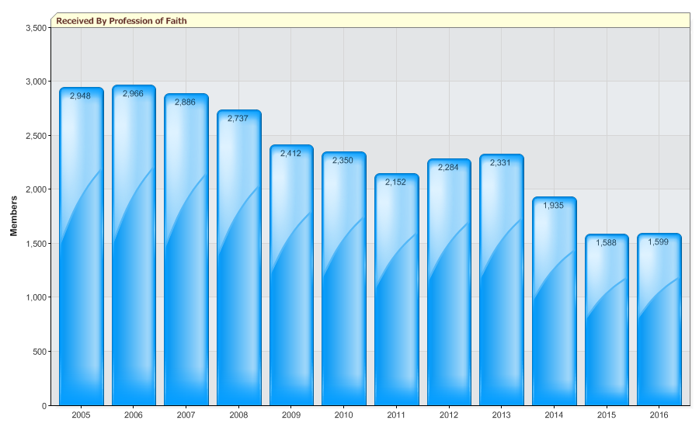
 | Eastern Pennsylvania Annual Conference

Slide 9
BENEVOLENT MISSIONS
Amounts given to UMC and other causes
$3.1 to $3.8mm raised annually
Upward trend over last four years

